Slide 1
IDAE Users’ Manual The Integrative Data Analysis Environment for Brain PET
Hiroto Kuwabara, MD, PhD
Radiology, Nuclear Medicine
Johns Hopkins University School of Medicine
IDAE Team members: Ayon Nandi, Junhua Mei

Slide 2
Introduction to IDAE
The integrative data analysis environment (IDAE) is a comprehensive data analysis system for brain research using PET (and MRI):
Users can generate & manage (customize) analysis packages (a.k.a., pipelines), carry out the analyses, and summarize the results, all via GUI and clickable, organized menus alone (minimal editing).
IDAE is primarily intended to aid non-technical researchers such as neurologists, psychiatrists, and neuroscientists to perform PET data analyses, and thus presents the user with a step-wise procedure
IDAE is project oriented: Analysis packages interact with the study’s database to perform analyses on groups of subjects, which made result-summary functions possible
A ‘study’ (a.k.a. ‘project’) refers to studying groups of subjects to address scientific hypotheses
Final products from IDAE for a study will be tables and figures for publications
IDEA’s modular programming makes it easy to for technical scientists to incorporate free-ware or their own codes to analysis package bases
IDAE is built upon MATLAB (thus, independent to operating systems)
Analyses are carried out as outlined in the Flowchart (next slide)
Users select / customize IDAE-supplied analysis package bases as needed for a study using GUIs alone
Stage 1 packages deal with preparation of PET, MRI, and VOIs (volumes of interest)
Each study typically has a few Stage 1 packages
Stage 2 packages deal with everything else. a few/several Stage-2 packages per Stage-1 package
Users prepare / update a database file (one per study) using GUI-based modules.
The database interacts with user-managed packages when carrying out the analyses.
Users can summarize the results (tables & figures) and perform statistics via GUIs alone
Local managers are required to local adaptor codes using a template to cope with site-specific data archive conventions (paths) and other settings.

Slide 3
Analysis Flowchart
Preprocessing of PET and MRI
Preparation of VOIs
[Stage 1 Packages]
Study’s Database
Local Directory System file
Preparation of
Stage 2 packages
TAC Generation
Plasma TACs, if any
Model Parameter Estimation
[Stage 2 Packages]
Map Generation
(Spatial normalization + Smoothing)
Summarize results
(Figures, Tables, Statistics) Voxel-wise Statistics (SPM)
Flowchart showing major analysis components of brain PET studies. In IDAE, the database of the study interacts with a few Stage 1 Packages and several Stage 2 packages to carryout analyses on groups of subjects.
VOI: Volume of interest; TAC: Time-activity curve

Slide 4
Performing Analyses with IDAE
The next two slides outline the way analyses are performed using GUIs in IDAE
To start a session of a desired package of a desired ‘project’:
Type as follows in Matlab command window: >> startIDAE yourUserName
Hit intended GUIs in successive GUI windows (three clicks alone)
Then the Level 1 Window of the intended package will pup up.
Now, observe the L1W for completion statuses of subject-analysis block GUIs (the main GUI matrix)
Visit the subject-analysis block GUI that shows the lowest completion percentage
In the Level 2 Window that pops up, look for interactive (=i; darker green) and quality control (=c; lighter green) processes that display ‘r’ (=ready) on GUIs. Just visit/complete the process. Then, ‘r’ turns to ‘c’ for completed.
Once interactive and/or quality control processes are completed on intended subjects, highlight their subject GUIs (hit GUIs) on L1W and hit the ‘Perform’ GUI.
IDAE will stop processing at the first interactive or quality control (QC) process to work on in individual subjects
Repeat the sequences until all processes are done on all subjects / scans.
Above performance principles apply to all IDAE packages that are shown in ‘Analysis Flowchart’

Slide 5
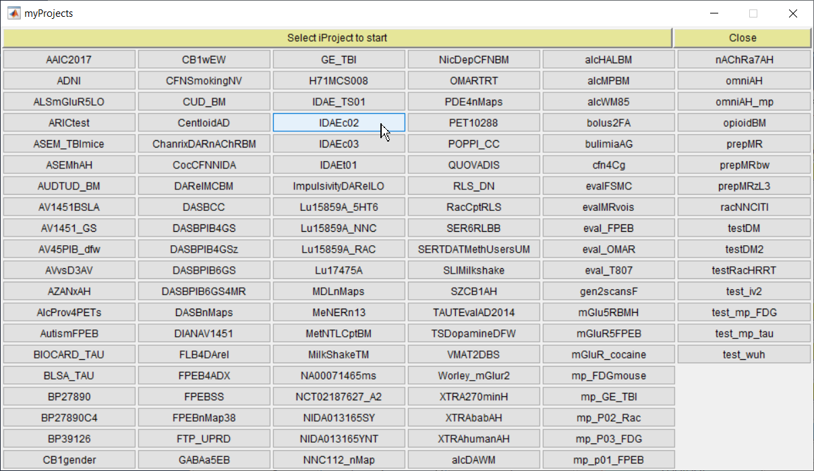
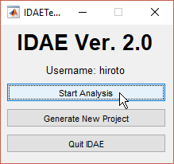
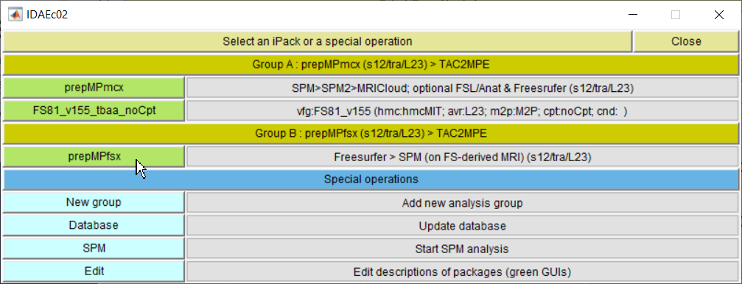
Starting an IDAE Session
Sequences for starting an analysis package of a project (Indicated by blue arrows; 3 clicks alone):
Hit ‘Start Analysis’ in the IDAE Control Module (left)
Hit the GUI of the intended project in the Project Selector window (middle)
Select the intended package from the package list of the project (lower panel)
Then, the Level 1 Window of the package (prepMPfsx) will be generated (next slide)

Slide 6
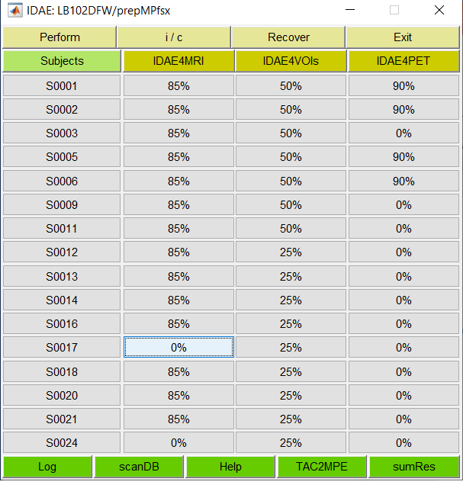
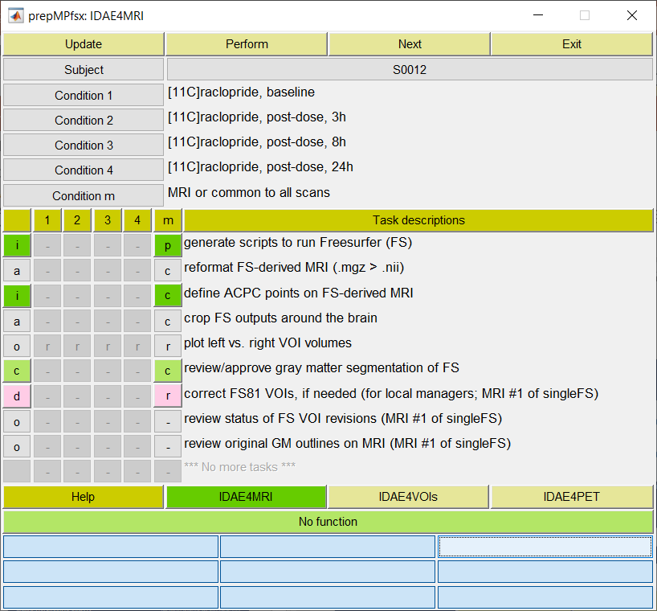
Carrying on Analyses with IDAE
Level 1 Window (L1W)
Level 2 Window (L2W)
Analysis Blocks
Subjects
Workflow
General sequences of performing analyses with IDAE:
Observe the Level 1 Window (left) for completion statuses of subject-analysis block GUIs (the main GUI matrix)
Hit the subject-analysis block GUI that shows the lowest completion percentage to get the Level 2 Window (right)
Look for interactive (=i; darker green) and quality control (=c; lighter green) processes that display ‘r’ (=ready) on GUIs.
Just visit/complete the process. Then, ‘r’ turns to ‘c’ for completed.
Once interactive and/or quality control processes are completed on the intended subjects, highlight their subject GUIs (hit GUIs) on L1W and hit the ‘Perform’ GUI (above ‘Subjects’ GUI).
IDAE will stop processing at the first interactive or quality control process to work on in individual subjects
Repeat the sequences until all are done

Slide 7
Installation of IDAE
Plan & create the following folders for IDAE
One folder for IDAE codes (e.g., C:\idae; referred to as ‘IDAE folder’)
Folders (one per user) for execution of IDAE (e.g., C:\users\UserName)
One folder to dump intermediate files (e.g., C:\tmp)
Place ‘scratch.m’ (any content; using MATLAB editor) in the dump folder
Download the IDAE package from GitHub to the code folder and unzip it (unzip ‘here’)
Look for patches/additional releases occasionally. Do the same for them.
Prepare a startup.m using IDAE-supplied template and place it to the directory where MATLAB looks when it is stated
See the section of ‘Preparation of startup.m’ for details
Prepare the local adaptor file in the dump folder
See the section of ‘construction of local adaptor file’ for details

Slide 8
Initial Set-up for IDAE (JM)
Preparation for using IDAE:
Mount shared drive/server hosting IDAE
\We trust you do not explore other directories of K due to presence of HIPPA sensitive materials.
Create a folder to dump intermediate files (C:\tmp)
Place ‘scratch.m’ (any contents) in the dump folder
Copy X:\tmp\startup_K.m to where MATLAB looks in when started (typically C:\Users\junhua\Documents\MATLAB) and rename it to startup.m
Restart MATLAB and confirm the you have K:\mxxs12 folders in your path
Setting the first project
Let’s set it in a primitive way (more user-friendly ways later)
>> iv2_serFolders(‘dxetc4hkx’, ‘junhua’, ‘IDAEc01’, 2);
Note that quotation marks are not copied correctly.
Create X:\users\junhua\idae if above line does not work well.
Replace your IDAEc01_scanDB.m with lines 1 through 32 of my IDAEc01_scanDB.m (folder: X:\users\hiroto\idae\IDAEc01).
Then, index your IDAEc01_scanDB.m as follows:
>> iv2_register X:\users\junhua\idae\IDAEc01\IDAEc01_scanDB.m junhua
Create X:\tmp\Freesurfer\junhua (added on 1/20/22)

Slide 9
Preparation of startup.m

Slide 10
 | Take a directory where you have processed PET-related files: X:\abc\fdaha\PET220211\am\103123\pet_data
 | Let’s assume you choose to place files from IDAE in subfolders ‘idae’: X:\abc\fdaha\PET220211\am\103123\pet_data\idae Identify the subject ID segment, segments that are shared with the PET-MRI server, and segments that vary.
 | Replace the special segments with designated special segment strings X:\abc\$\link_seg_1\#\link_seg_2\pet_data\idae Note that ‘fixed’ segments between special segments are treated as varying segments

Slide 11
Construction of the Local Adaptor File
IDAE assumes the following 4 computer classes
They could be physically identical (e.g., local file server = PET & MRI server)
The local IDAE manager is requested to generate the local adaptor file:
Once alone
Starting template: inq_windows10.m (if Window > Linux) or inq_Linux.m otherwise
See next slide for more explanations
Once the template is done, submit it to iv2_gen_dxetc4xxx.m as follows:
>> iv2_gen_dxetc4xxx(‘inq_whichever’, ‘dxetc4whatever’)
where the second input is the name of local adaptor file of your choice.
Computer classes | Descriptions | Supported OS
Users’ workstation | PCs or workstations to run IDAE | Windows 10 / Linux
Local file server | To store outputs from IDAE will be generated by IDAE organized by subjects and PET & MRI scans | Windows / Linux
PET & MRI server | To provide reconstructed PET and MRI files | Windows / Linux
Linux machine | To run Linux-based applications for IDAE | Linux

Slide 12
Construction of the Local Adaptor File
[reminders for later use]
Setting for Freesurfer
Set dxetc4xxx such that >> x = dxetc4xxx(‘fsd’,’avatar948’) returns:
x.fs.home: the full path of the folder to place IDAE-generated scripts to run Freesurfer
x.fs.linux: the same as x.fs.home but the full path in the Linux system where Freedsurfer is installed
x.fs.subj: the full path of the Freesurfer’s working directory (e.g., /home/avatar948/freesurfer/subjects)
Place a text file (name: FS_done.txt; any contents) in your x.fs.subj
Yong Du kindly agree to be a test site for preparation of the local adaptor file
Ours: dxetc4hkx.m
Two ways we can test:
Junhua gets into their system and complete the local adaptor file
Yong or his people construct the file using the instruction
Whichever, we need to provide the distribution set Junhua created.

Slide 13
Setting the first project
The IDAE team suggest to set the first project in a manual approach
Why manual approach? To help users understand the basic mechanisms better
Users can find GUI-based approaches here
Hypothetical strings of this manual. Need to replace them by actual strings
‘dxetc4xxx’ stands for your local adaptor file.
‘avatar948’ stands for a hypothetical IDAE user.
‘IDAEc01’ stands for a demonstration project.
Type (and hit return) as follows MATLAB command (>> indicate MATLAB command lines):
>> iv2_serFolders(‘dxetc4xxx’, ‘avatar948’, ‘IDAEc01’, n);
n stands for the number of PET scans per subject in the project
Note that quotation marks are often not copied correctly to MATLAB command window
Don’t forget to create the user folder (See Installation of IDAE).
The database template (X:\users\avatar948\idae\IDAEc01_scanDB.m in this manual) will be generated and opened for editing
Edit the scanDB.m as instructed therein:
Once completed, save & index it as follows:
>> iv2_register X:\users\avatar948\idae\IDAEc01\IDAEc01_scanDB.m avatar948
Again, need to replace hypothetical strings with actual ones
If the indexing is successful, move on the next step.

Slide 14
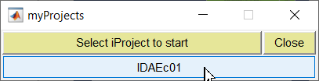
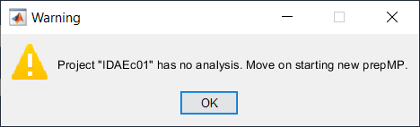
Setting Stage 1 Package for Projects
Enter as follows in the command window:
>> startIDAE avatar948 dxetc4xxx
To open the myProject module (left)
The module display one project alone since this is the first project
The number will grow as more projects are accumulated (See ‘Starting an IDAE Session’).
Hit the project GUI (‘IDAEc01’).
It is ‘as-expected’ to get a warning sign (right panel).
Just hit ‘OK’ to proceed to composing the first Stage 1 package for the project (next slide)

Slide 15
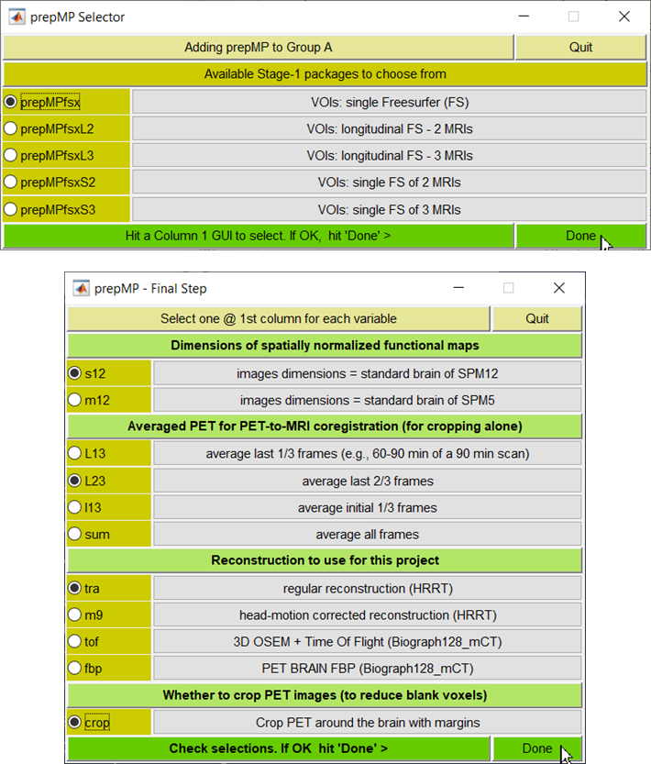
Preparation Stage 1 Packages
Just 7 clicks (< 10 s) to get ready to start the analysis with a Stage-1 package
Select ‘prepMPfsx’, the only Stage-1 package in this release and hit ‘Done’ (upper panel)
Select parameters in the 4 sections in the next module (lower panel) and hit ‘Done’
Read ‘Information’ tabs (light green)
Averaged PETs are used for obtaining a global TAC to understand if individual scans have any problems (such as early termination, scan breaks)
Available options are convenient for this purpose which may need to cope with different durations of scans
For example, L23 will use 30-45 min frames if the scan terminated prematurely at 45 min instead of the planned 90 min
Note that ‘sum’ is a good option as well
The local IDAE manager needs to set the last two sections (reconstruction & cropping) in the local setting file (dxetc4xxx.m)
Then, Level 1 Window (L1W) will pop up. Users are ready to start the analyses.

Slide 16
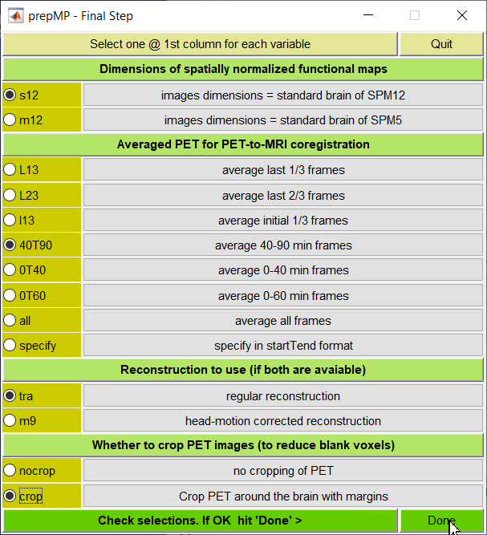
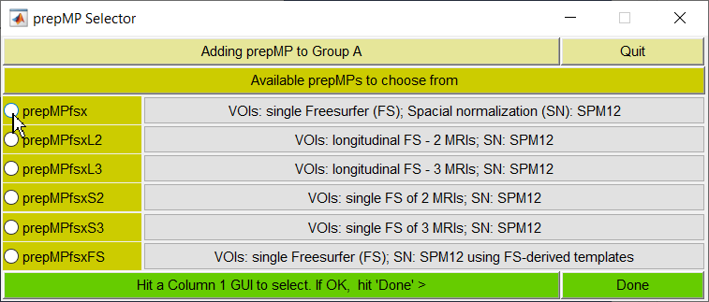
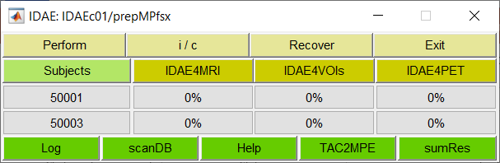
Completing Stage 1 Packages
Just 7 clicks to the completion of a Stage-1 package:
Select ‘prepMPfsx’, the only Stage-1 package in this release and hit ‘Done’
Select recommended parameters in the next module (right panel) and hit ‘Done’
Read ‘Information’ tabs (light green)
Averaged PET is primarily used for cropping PET in Stage-1 (not so critical)
Then Level 1 Window will pop up (left bottom). You are set to start the analysis.

Slide 17
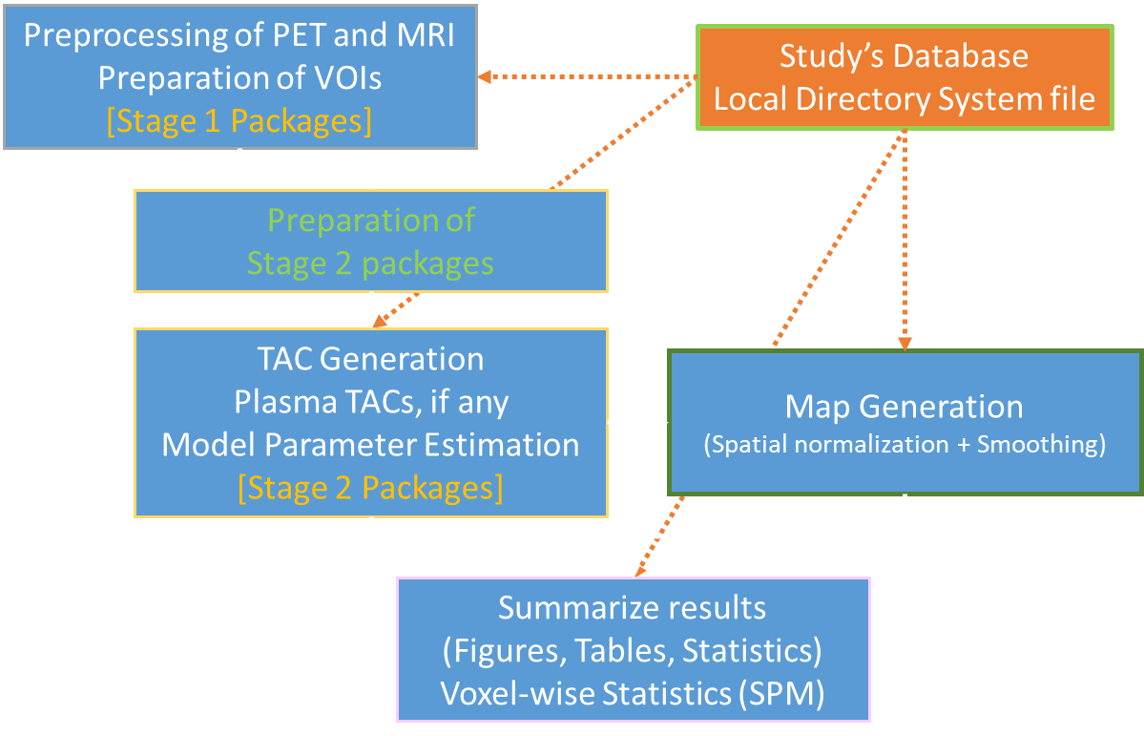
Outlines of ‘prepMPfsx’
Three analysis blocks in prepMPfsx
Automated parcellation of brain regions using the Freesurfer software* for (block name: IDAE4MRI). Major steps include:
Generation of scripts for running Freesurfer outside IDAE (to avoid stalling MATLAB)
Visual confirmation of the outputs using outlines of gray matter regions
Manual correction of insufficiencies, if any (optional)
*Available at: https://surfer.nmr.mgh.harvard.edu/fswiki/FreeSurferWiki
VOI-related operations (IDAE4VOIs) (VOI = volume of interest):
Selection of VOIs to refine (to focus) and reference regions
Manual refinement of above-mentioned (and added non-Freesuefer) VOIs
PET-related operations (IDAE4PET):
Cropping of PET frames around the brain with margins, if selected.
Initial coregistration of averaged PET to the Freesurfer-derived MRI
Visual evaluation/correction, if needed of the coregistration
Visual evaluation of head motion

Slide 18
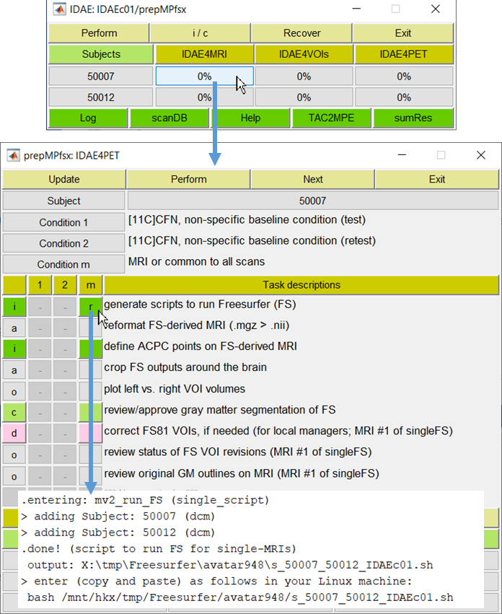
Generate scripts to run Freesurfer (FS)
General sequences of performing analyses apply here as well:
Visit the subject-analysis block with the lowest complete percentage in L1W
Visit the first interactive (=i; darker green) or quality control (=c; lighter green) processes that displays ‘r’ (=ready)
The application opens with files selected
In this step, the command line to submit to your Linux machine (→) will be displayed on MATLAB command line (bottom row). Just copy and paste/submit it.
Up to 3 MRIs were submitted at one time
[Some technical notes]
information on the access to Freesurfer, etc. is defined in your local adaptor file.
IDAE chose to run Freesurfer outside IDAE to avoid stalling MATLAB while execution of Freesurfer (~6 hours per MRI)
L1W
L2W

Slide 19
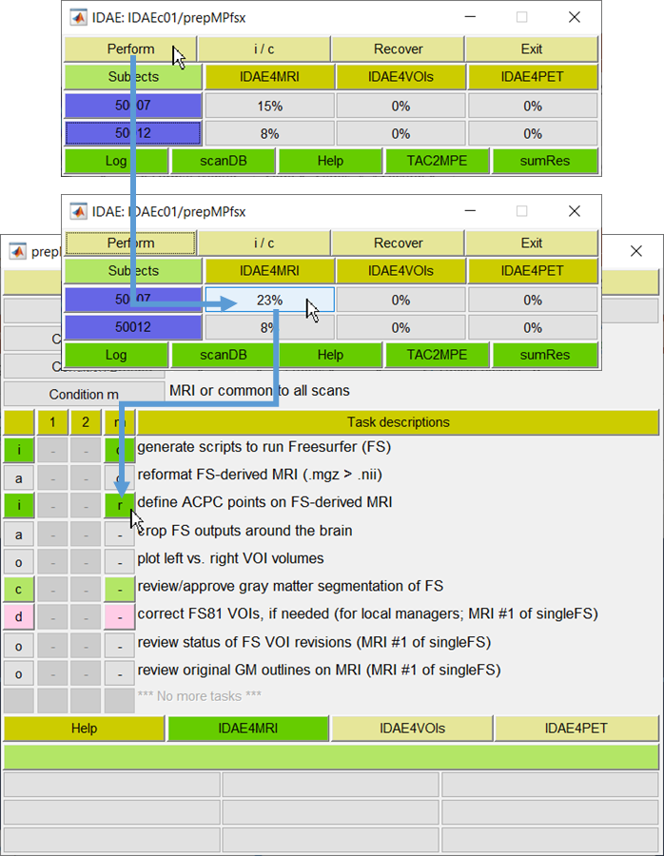
Define ACPC Points
Assume that the Freesurfer script was submitted yesterday, and the user revisited the project/package
The percent completion statuses increased on GUIs under IDAE4MRI.
So, highlight subject GUIs (now deep blue) and hit the ‘Perform’ GUI in L1W to perform available automatic processes (= ‘a’ in L2W)
Completion statuses increased on the first subject (15 to 23%) but not for the second subject [i.e., Freesurfer not completed yet].
Open L2W (middle then bottom panels)
Look for the first dark or light green GUI with ‘r’ (=ready) which is ‘define APCP points on FS-derived MRI’ (right column) in this example
Hit the ‘r’ GUI to open the application, VOILand with files selected (next slide).
L1W
L2W

Slide 20
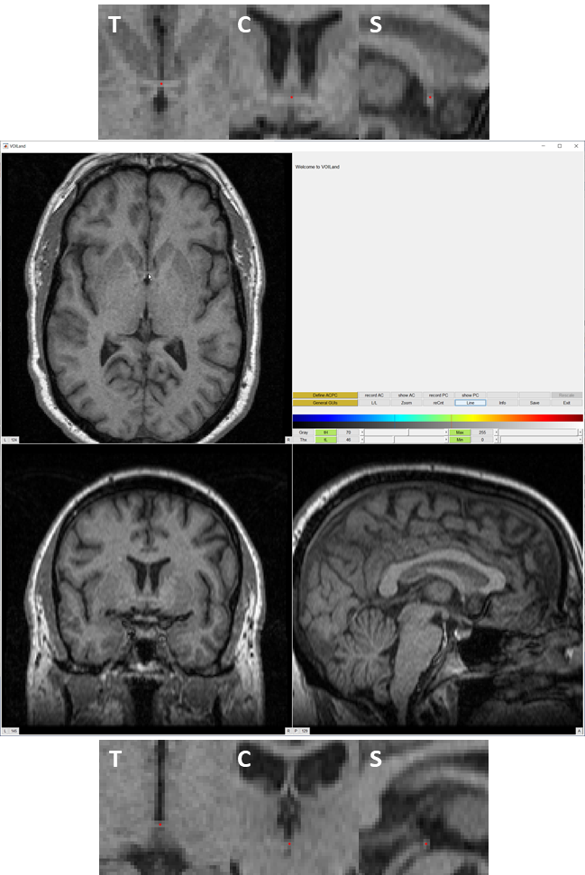
Defining ACPC Points
Define the anterior and posterior commissure points (AC and PC) on the MRI
To be consistent with SPM12 which assumes the AC as the origin of the image coordinate system
Procedures:
Navigate images to display the AC point in all orthogonal images (middle panel)
Image navigation: Hit u/n keys (for up/down in axial direction), i/m keys (towards the inion/nasion, but m), </> keys (towards your left/right)
Click at any point on the colormap bars when above keys do not respond
Hit at the AC point (arrow in the trans-axial image) to display red dots (one per view)
Fine adjustments using number keys: Hit 8/2 keys to displace the dots in anterior/posterior directions, 4/6 to keys to towards your left and right, and 9(Pg Up)/3(Pg Dn) in the up(=cranium)/down directions
Target: Slightly above the center of the AC point (See upper panel)
Hit ‘save AC’ GUI when done
Repeat the same for the PC points
But at the middle of PC (bottom panel)
Make sure to click on ‘Save’ then ‘Exit’ GUIs (after seeing ‘safe to exist’ message).
AC
PC
Not sure about ACPC? Try https://people.cas.sc.edu/rorden/anatomy/na_ac.html

Slide 21

review/approve gray matter segmentation of FS
The percent completion status increased since the ACPC points were set.
Hit the ‘Perform’ GUI on L1W to run automatic processes through the next interactive or QC process.
Once done with increased percentages, hit the subject-block GUI again.
Now, the first dark or light green GUI with ‘r’ (=ready) says it’s time to ‘review/approve gray matter segmentation of FS’
Hit the GUI to open the application (snOLs.m) for visual inspection (See next slide).
Consequences:
Move on to the next block (for this subject) if you approve the outputs from Freesurfer
If not (i.e., some problems), move on the correction of Freesurfer-derived VOIs
Only trusted users (defined in dxetc4xxx) are allowed to access this optional step (pink)
L1W
L2W

Slide 22
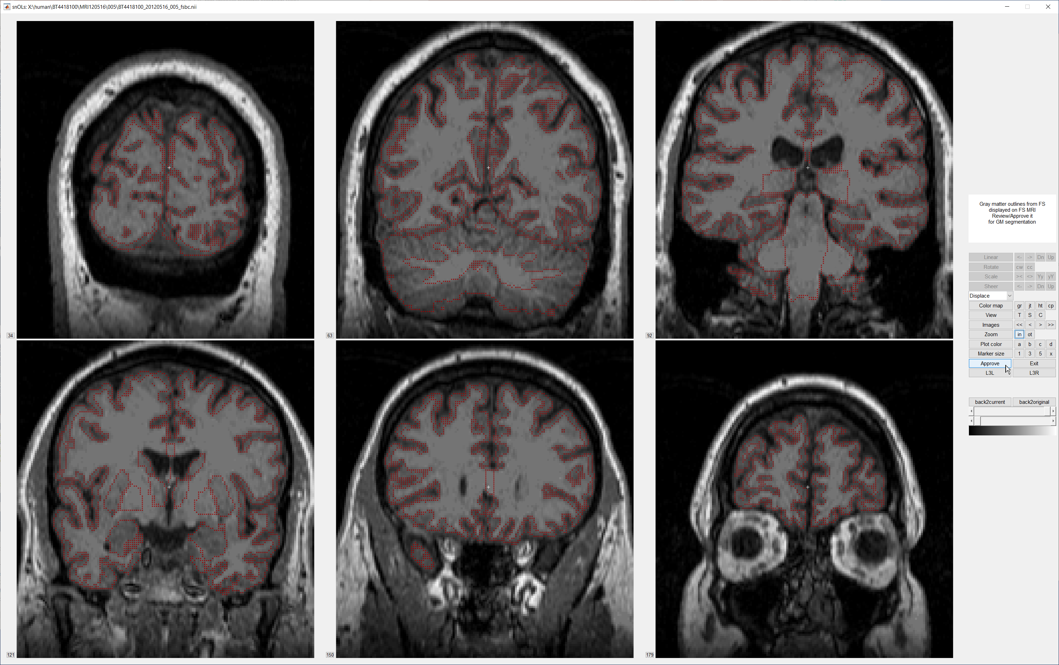
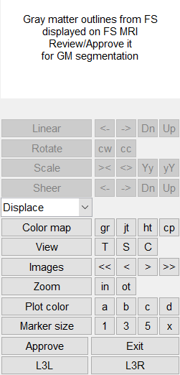
Review/Approve GM segmentation of Freesurfer
The outlines of gray matter (with all GM VOIs merged) from Freesurfer are projected on MRI in three orthogonal views in turn (5 s per view)
Evaluate if GM outlines agree with GM of the MRI. Hit ‘Approve’ GUI if OK (arrow)
Use T (trans-axial), S (sagittal), and C (coronal) GUIs under ‘view’ to change views.
Use arrow GUIs under ‘Images’ to navigate ‘slices’

Slide 23
To Make Interactions with IDAE Enjoyable
Sometimes users could be frustrated by the behavior of IDAE
Most of them are caused by users’ unexpected behaviors in our experience.
Thus, keep in mind:
GUIs are often left ‘active’ after a GUI is clicked. Thus, MATLAB (and IDAE) will be confused if any GUI is hit before on-going instruction is completed.
So, please be patient until the emitted task is completed.
The development team try to include ‘be patient .. ‘ messages as much as possible
MATLAB command window shows the ‘busy’ sign at the bottom
When questionable, hit ‘return’ in the command window. The sign may appear if it is processing. If you do not see the ‘busy’ sign, you are good to emit the next command

Slide 24
IDAE4VOIs
Set VOIs to refine/define for the project
Background: IDAE makes use of Freesurfer-generated VOIs. It appears to be practically impossible to refine all the VOIs (>85) in every MRI.
IDAE provides two sets of VOIs for the sake of convenience: FS81 that are almost identical to original Freesurfer VOIs; and FS45 with VOIs re-organized to be conventional larger VOIs.
IDAE’s strategies to cope with the issue:
To set & refine a subset of the VOIs that are critical for the project (denoted as ‘S’ VOIs)
To set & define from scratch those VOIs that are not generated by Freesurfer (= ‘S’ VOIs also)
To set & refine/define reference regions (target-free regions; need one even none) (= ‘R’ VOIs)
Set the S/R VOIs at ‘set VOIs for this project’ (the first task of IDAE4VOIs)
Hit the GUIs of intended VOIs (toggles among ‘no-mark’, ‘S’, and ‘R’) in the module which pops up when the task GUI is hit on L2W.
Record the selections when done (See next slide) as a set of VOIs
Users can add ‘S’ and ‘R’ VOIs later as needed (changes from ‘S’/’R’ to ‘no-mark’ are not allowed). The displayed selections will be saved as a new set upon completion of the saving processes.
Refine/Define ‘S’ and ‘R’ VOIs, separately for FS81 and FS45
Visit FS81 and/or FS45 versions according to the setting of ‘S’ and ‘R’ VOIs

Slide 25
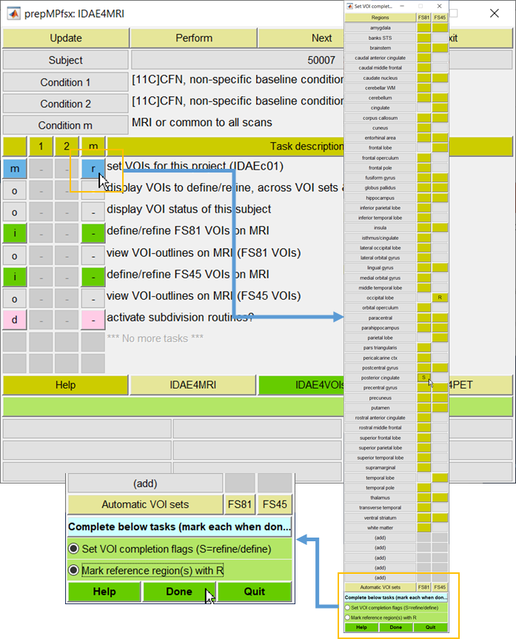
IDAE4VOIs: ‘Set VOIs for this project’
Popup the VOI setter module
Hit the first GUI (arrow & orange rectangle)
Columns are for:
FS81: almost identical to Freesurfer VOIs
FS45: a reorganized version of FS81 into conventional larger VOIs
Colored GUIs indicate available VOIs from Freesurfer
Hit the GUI of the intended VOI in the module
Toggles among ‘no-mark’, ‘S’, and ‘R’
Hit a ‘(add)’ GUI to add non-Freesurfer VOIs
Selections shown in this manual are for demonstration purpose alone
Once all intended VOIs are marked:
Check if all ‘S’ VOIs are marked (none is OK)
Check if all ‘R’ VOIs are marked (at least one)
Then, hit ‘Done’
Make use of 2nd and 3rd tasks (‘display VOI…; marked by a orange bar) of L2W to monitor completion status of the ‘S’ and ‘R’ VOIs in individual subjects
It’s convenient to know which MRI to work

Slide 26
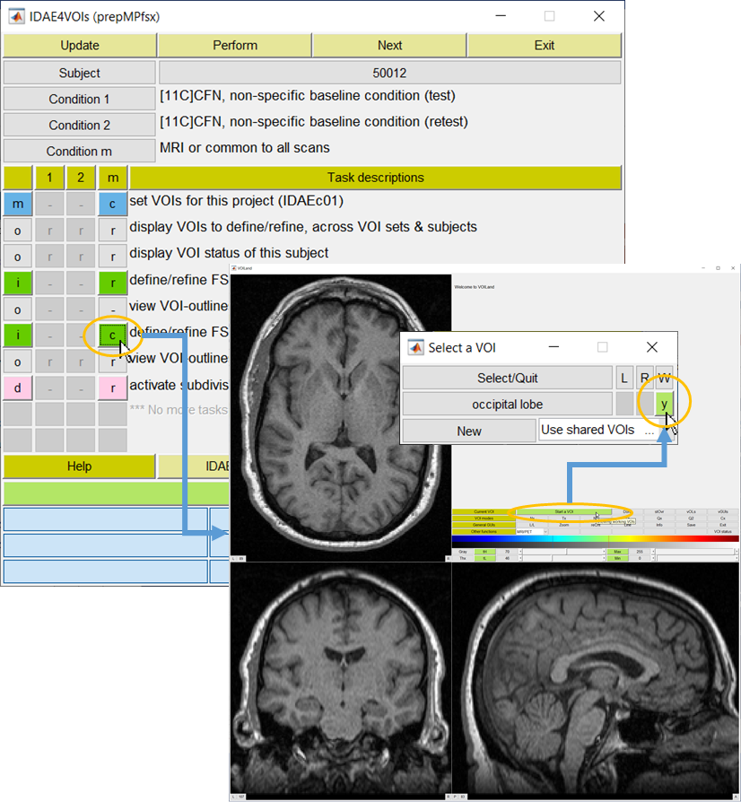
Define/Refine VOIs
Hit the green (One each for FS81 or FS45 VOIs) GUI (left orange circle):
The application, VOILand will open with input (MRI) and output (VOI) files selected.
Hit ‘start a VOI’ GUI on the VOILand window to open the VOI selector (inset)
The ‘S’ and ‘R’ VOIs will be listed here.
The occipital lobe in this example which is defined in FS45 set alone. Therefore, the FS45 set was hit (the second green GUI).
‘y’ means not worked yet.
See the VOILand manual to learn how to refine/define VOIs.
Good to know:
IDAE generates one set each of FS81 and FS45 VOIs to be shared by users.
Users are not allowed to edit the shared sets
User-defined ‘S’ and ‘R’ VOIs were copied from the shared sets to users’ personal files, if present.
Both shared and personal VOI files are used when to generate time-activity curves, TACs.

Slide 27
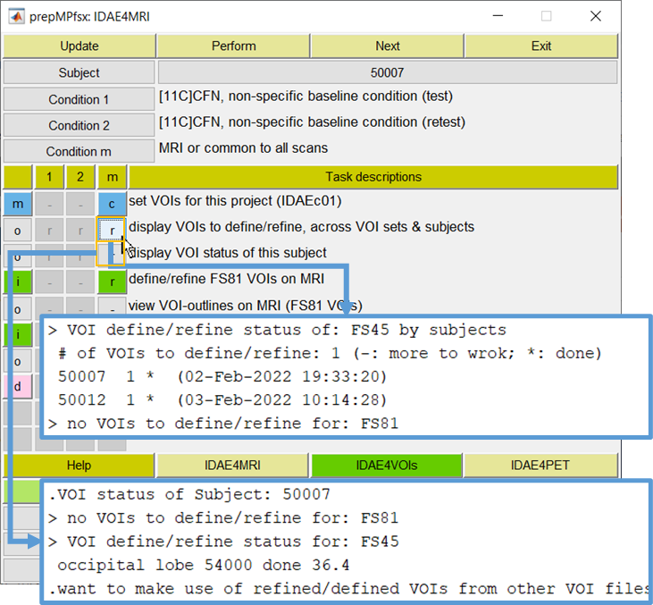
Convenient Option Processes for VOIs
Two optional processes could be very useful to know which VOIs of the ‘S’ and ‘R’ VOIs are left incomplete
‘Display VOIs to define/refile, across VOI sets & subjects’ (upper GUI)
Will list # of VOIs to define/refine (i.e., ‘S’ + ‘R’) and completion statuses of individual subjects (- if left incomplete; * if completed with date/time of completion
Thus, the user can visit those incomplete sets and subjects.
‘Display VOI status of this subject’ (lower)
Will list VOIs to define for this subject, separately for FS45 and FS81 VOI sets.
In sum, know which subject to work from the upper GUI, and which VOIs to work for the subject from the lower GUI
In addition, a GUI (VOI status) is provided to display VOI completion statuses of the ‘S’ and ‘R’ VOIs on the VOILand window.

Slide 28
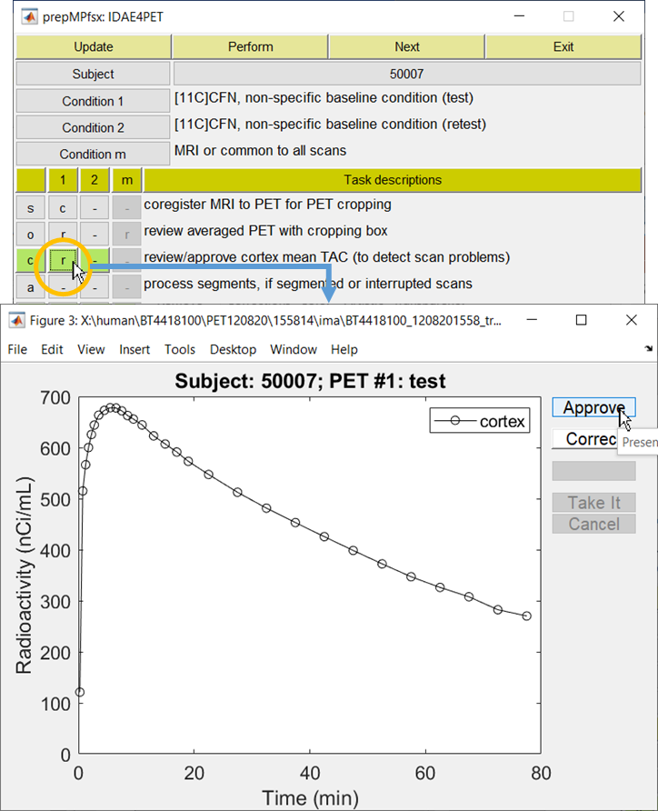
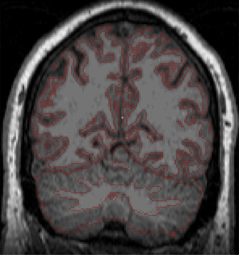
IDAE4PET: Mean Cortex TACs
Review/approve cortex mean TAC
Derivation of the cortex mean TAC
Marginal voxels of gray matter (red dots of the inset) were transferred to the PET according to the PET-to-MRI coregistration parameters and applied to successive PET fames
The user of marginal voxels is expected to be sensitive to head motion, if any
Hit the first light green GUI (arrow in orange circle) of L2W to display the plot
Look for any sudden dips (often suggestive of bathroom breaks), or shorter than expected scans (early termination).
If no such problems, ‘approve’ it (arrow)
Otherwise, visit ‘Correct’ GUI. Note that the local IDAE managers need to set this section according to local conventions
Once it is approved:
Highlight those subjects for whom mean TACs are newly approved in L1W and hit ‘Perform’ GUI to process a group of subjects, or
Hit ‘Perform’ GUI of L2W (top row) to process ready-to-run automatic processes of current subject

Slide 29
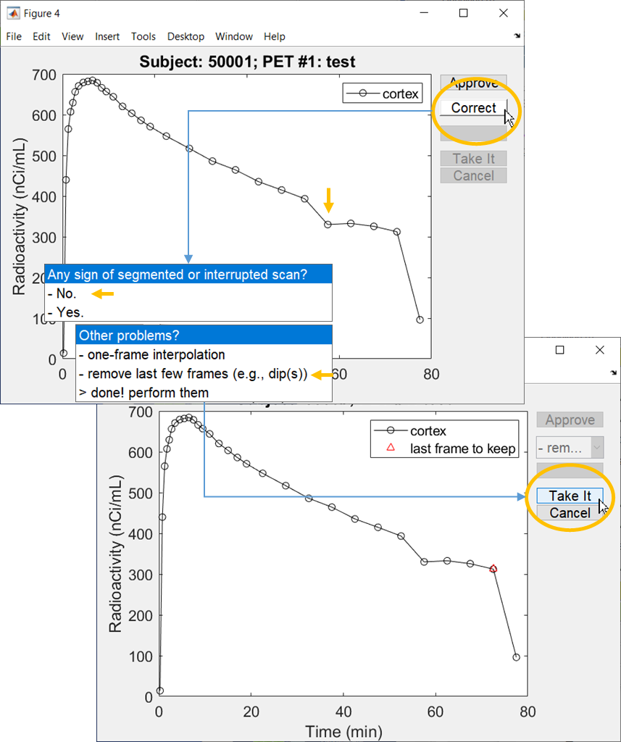
Correction of Potential Scan Problems
Some of scan problems can be ‘corrected’ at this stage, if any
In this example, the mean cortex TAC had a dip at the last frame and lesser dips just before 50 min (vertical arrow).
The dip at the last frame may not be ‘corrected’ but it is possible to eliminate the last frame from further analysis.
It may be possible to ‘correct’ the lesser dips by the head motion correction approaches
So, let’s eliminate the last frame
Procedures:
Hit ‘Correct’ GUI (upper orange circle)
Respond to successive inquiries
Correction approaches for segmented (by e. g., bathroom breaks) or interrupted (often planned) scan are site-specific (reconstruction approaches). Thus, those approaches are not included in the distribution set.
Point at the last frame to keep (red triangle) and hit ‘Take It’ GUI, if OK
The frames up to the red triangle (inclusive) will be used in subsequent analyses.

Slide 30
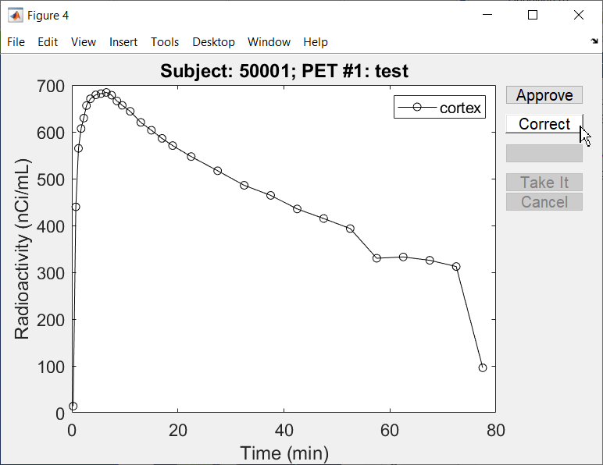
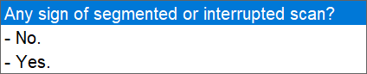
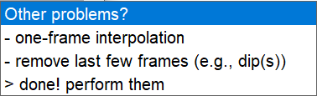
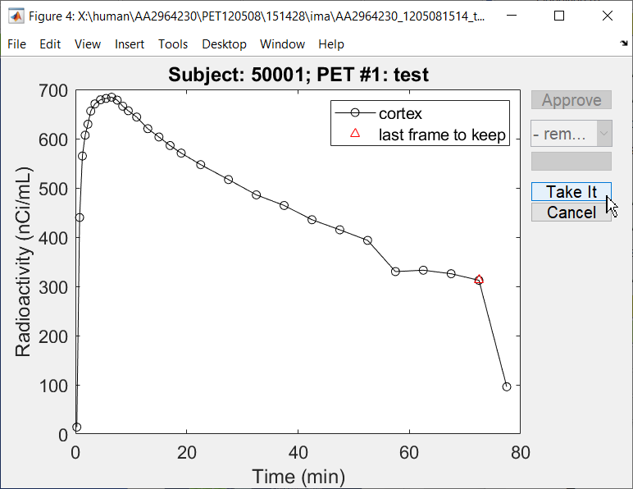

Slide 31
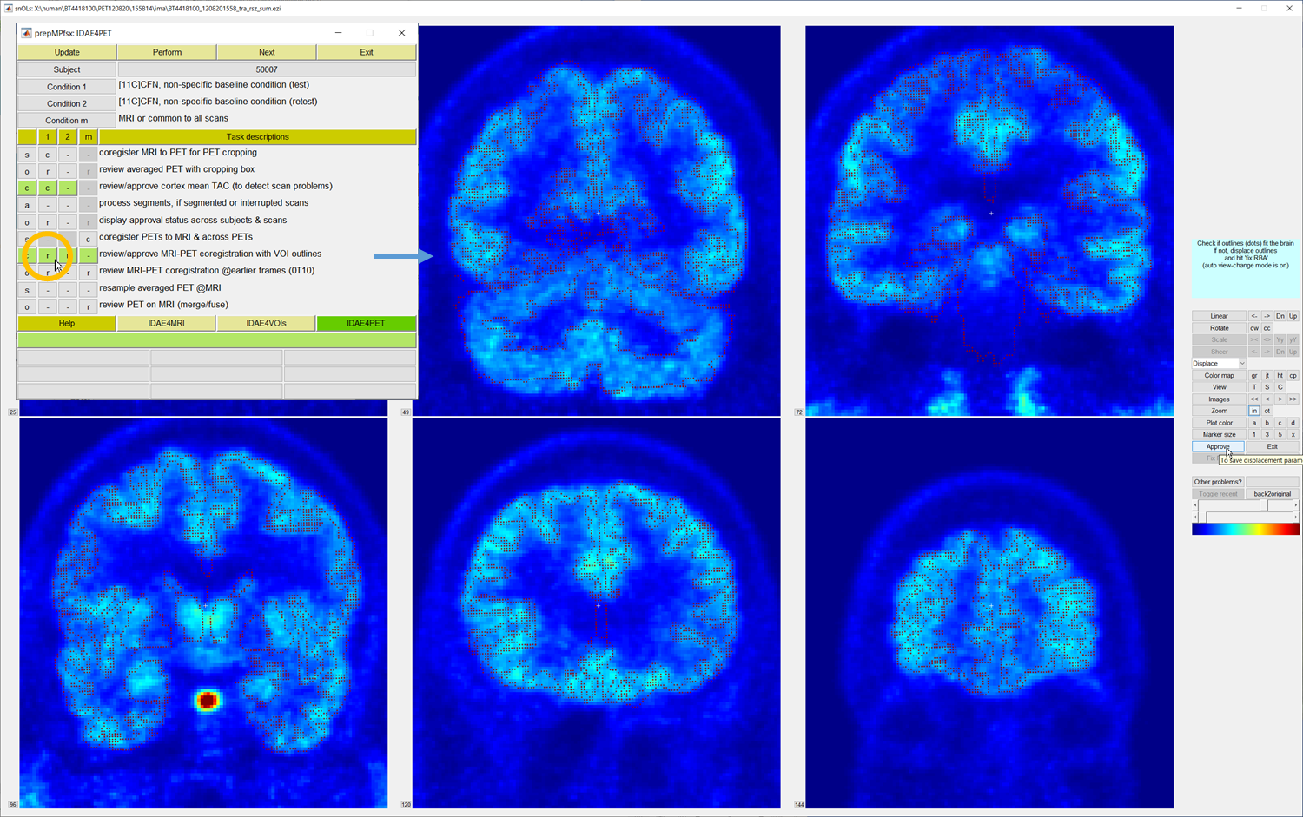
IDAE4PET: Coregistration QC
The outlines of gray matter (from MRI) are projected on the averaged PET volume
Evaluate if GM outlines agree with the PET volume. Hit ‘Approve’ GUI if OK (arrow)
Use T (trans-axial), S (sagittal), and C (coronal) GUIs under ‘view’ to change views.
Use arrow GUIs under ‘Images’ to navigate ‘slices’

Slide 32
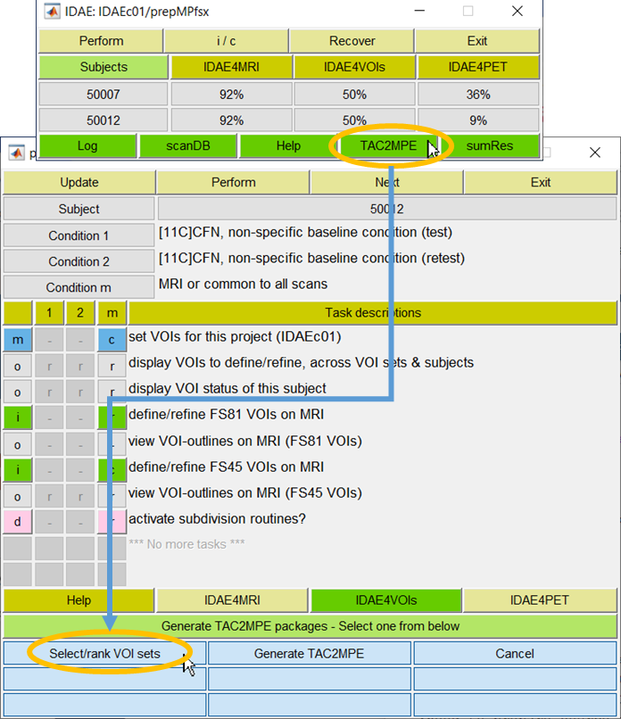
Preparation of Stage 2 Packages
Stage-2 packages are to generate TACs and perform model parameter estimation (MPE)
Usually there will be several Stage-2 packages per prepMPfsx due to:
Revisions of ‘S’ and ‘R’ VOIs
Selections of the parameters in the next step
Start the preparation with ‘TAC2MPE’ GUI of L1W (upper orange circle)
Two potential scenarios (lower GUIs of L2W)
To define ‘VOI sets’, select ‘Select/rank VOI sets’ tab (lower orange circle)
Move on to understand what are ‘VOI sets’
To apply a new set of ‘other’ parameters to a VOI set, hit ‘Generate TAC2MPE’ GUI

Slide 33
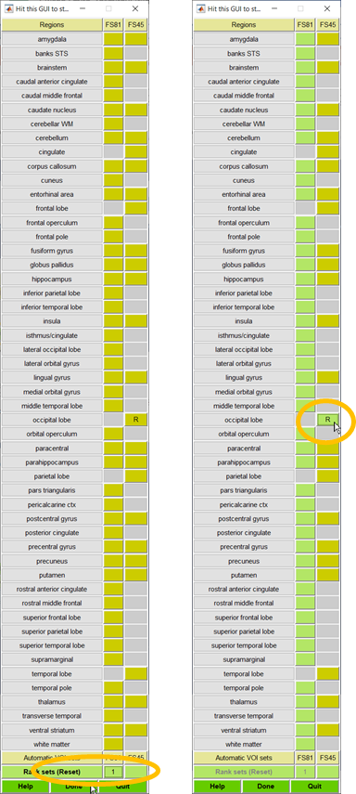
Setting VOI Sets
When the ‘Select/rank VOI sets’ tab was hit in L2W, the VOI selector module pops up
Previously defined VOIs to refine/define and VOIs for reference regions are indicated by ‘S’ and ‘R’, respectively
It is OK to have no ‘S’ VOIs as in this example.
But there must be at least one ‘R’ VOI
Dark gold regions are available VOIs. No revisions are allowed in this stage
Recall that F45 is consisted of merged VOIs from FS81.
It is strongly recommended to select the F81 set.
A later function allows calculation of the values of any outcome variables for merged VOIs as weighted means (by volumes) of FS81 VOIs.
In this example:
The FS81 set was selected (as 1 and only 1; bottom left circle)
Then, the FS81 VOIs are shown in light green (right panel)
The VOI for the occipital lobe, reference region for the tracer was set to refine in the F45 set since it is available on this side alone.
Just hit the VOI’s GUI to include the VOI to the VOIs to report (orange circle, right panel) (hit it one more time to deselect).
Hit the ‘Done’ GUI to set the next module

Slide 34
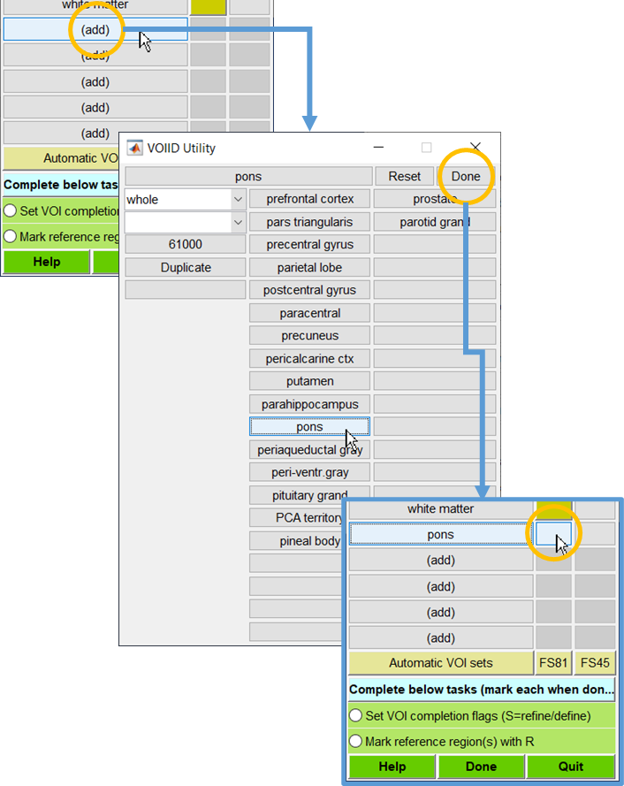
Adding Unlisted VOIs
Instructions for adding VOIs that are not listed under FS81 or FS45 using the pons as an example
Hit an (add) GUI (upper orange circle) in the VOI selector module to open the VOIID Utility module
Hit the key ‘p’ to list structures starting with p (middle panel)
Middle column: Brain structures
Right column: Non-brain structures
Hit ‘pons’ GUI to bring up the structure
Leave ‘whole’ on
Hit ‘Done’ GUI (right upper, middle panel)
The added structure will appear in the VOI selector module (lower panel)
The newly added VOIs are not defined by Freesurfer. Therefore ..
The user must specify it to ‘S’ or ‘R’, i.e., to define manually from scratch as a target (‘S’) or reference ‘R’ region, respectively
The VOI could be included in ‘FS81’ (orange circle) or ‘FS45’ set, depending on which is going to be the primary VOI set.

Slide 35
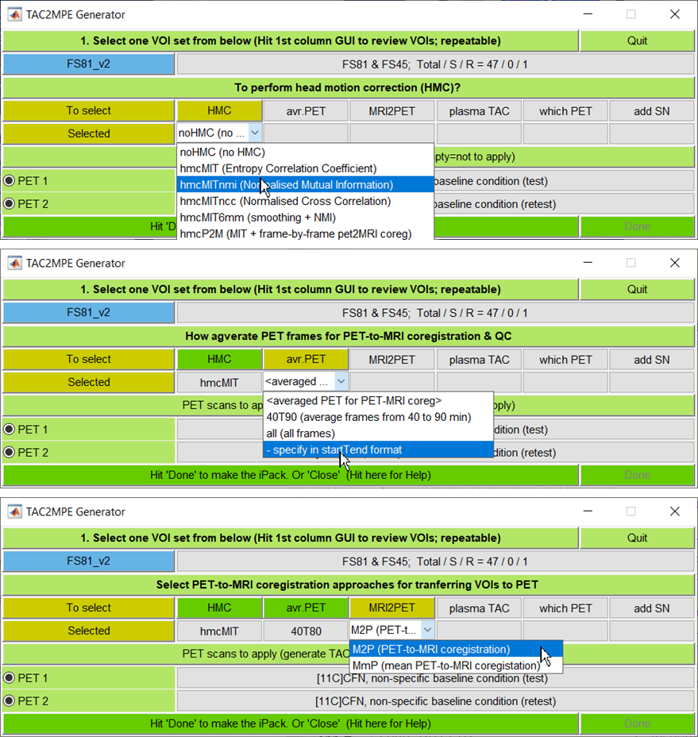
Setting Options for TAC2MPE: 1
TAC2MPE Generator module list the VOI sets the user has for this project
The name ‘FS81-v2’ (orange circle) was assigned to the VOI set that was set in the last slide
Next GUI explains the set: 47 VOIs from FS81 and FS45 (the occipital lobe alone) sets with 0 ‘S’ and 1 ‘R’ VOIs
Most VOIs have left and right VOIs
Hit the VOI GUI, and confirm the VOIs to start selecting options in succession
HMC: Head motion correction
No HMC or select one from the mutual information theory-based approaches using SPM12’s coregistration module.
‘avr. PET’: Frames to average for PET-to-MRI coregistration (second round)
‘40T90’ and ‘all’ are generic, suggestive choices
Consult with the study’s framing protocol (See next slide, if applicable)
MRI2PET: Approaches for PET-to-MRI coregistration (second round)
M2P is strongly recommended

Slide 36
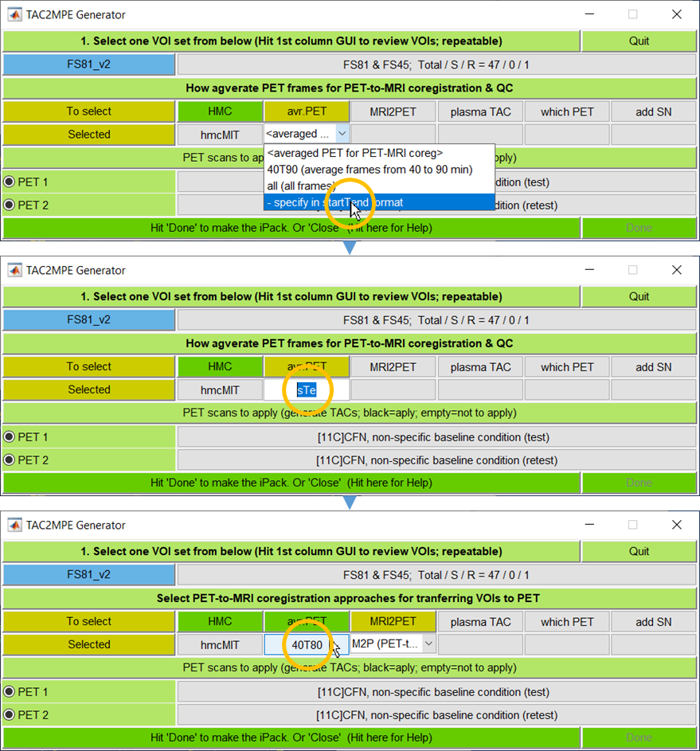
Specify Start/End Times for Frame Averaging
Aim: To specify PET frames to average for the purpose of PET-to-MRI-coregistration To transfer VOIs from MRI to PET spaces
Factors to consider:
Planned scan durations may be consistent across scans most studies but may be variable to learn the best scan durations for the tracers
There could be a common frames to use even in the latter case
To take earlier (e.g., 0-10 min frames; close to CBF images & higher counts) or later segments (e.g., 40-90 min frames; images are closer to the distributions of target molecule, thus critical for modeling)
How to specify frames in the module:
Select ‘- specify ..’ tab (upper orange circle). It turns to be editable.
Remove sTe (middle orange circle; to remind users to use the startTend format; e.g., 30T60 to mean to average 30-60 min frames) and enter yours (40T80 in the example; lower orange circle)
Make sure to hit return when done. Then, the next selection will appear

Slide 37
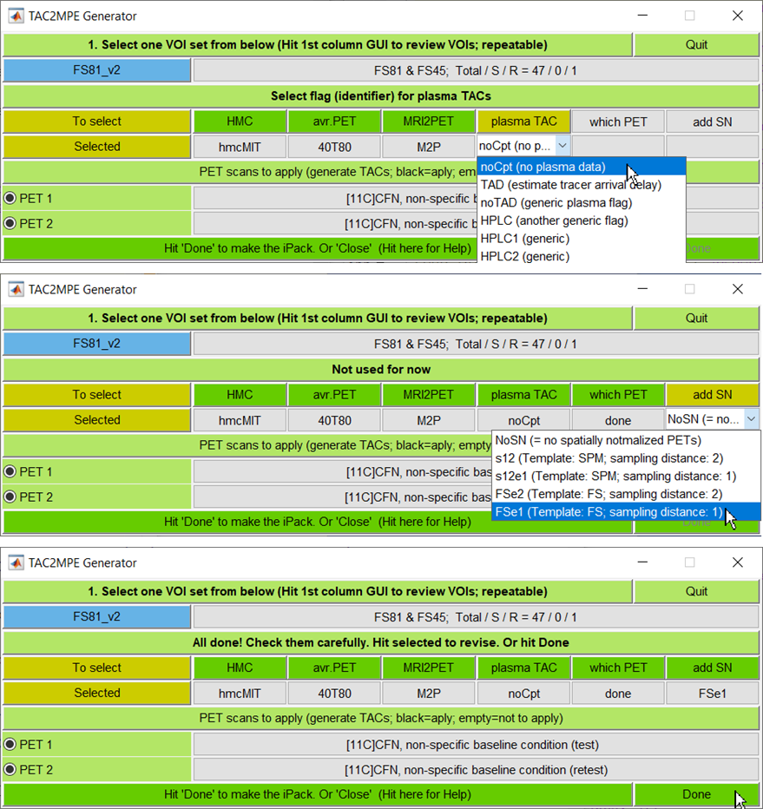
Setting Options for TAC2MPE: 2
Plasma TAC:
Select ‘noCpt’ if no plasma data
Select one of generic flags or enter the user’s own flag (postpended to the plasma files)
Note the descriptions of individual flags using the ‘NoteLine’ function of IDAE (add later)
Which PET:
Indicate which PET scans to apply this TAC2MPE package using check boxes of PET 1 and so on
Check scans to apply, and select ‘done’
Add SN: Whether to add spatial normalization of functional PET volumes
SPM12’s unified segmentation method
Templates: SPM-supplied or IDAE-supplied
Sampling distances for SPM12’s special normalization routine
MRI-based spatial normalization + PET-to-MRI coregistration will be used for spatial normalization of PET volumes
Review selections
Hit a GUI (e.g., 40T80 under avr. PET) to revise the selection
Hit ‘Done’ if all are as intended. Then, the package will be generated. Restart the project

Slide 38
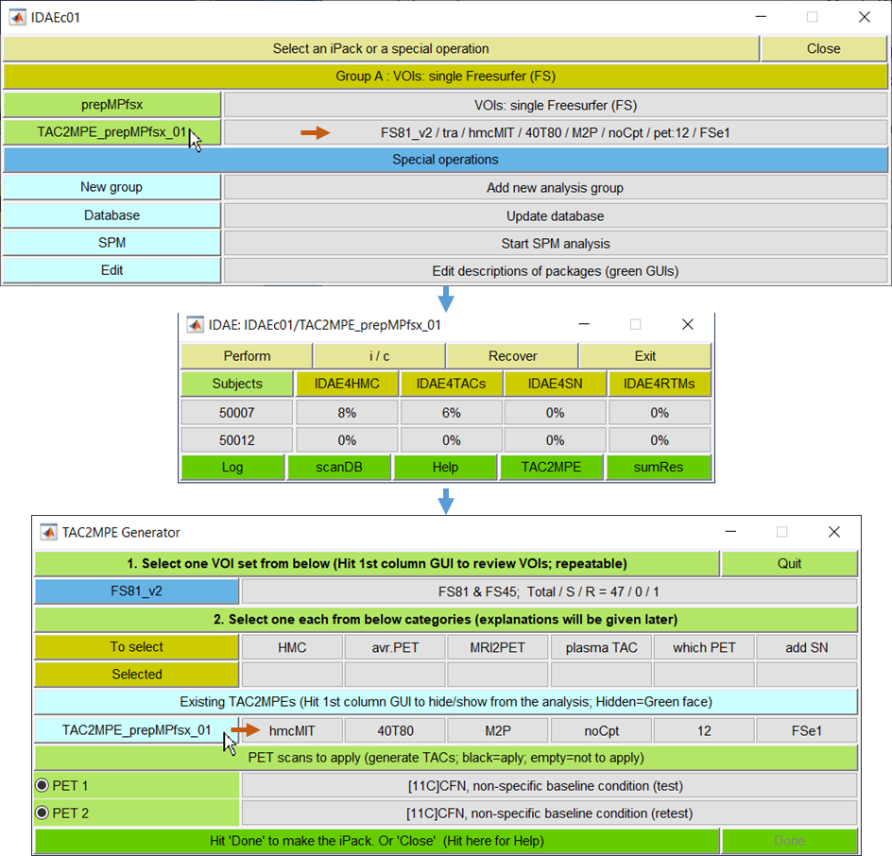
Starting Stage-2 Packages
The newly added Stage-2 Package will be listed under group A (=prepMPfsx) when the project is revisited (upper panel)
Selected options are listed on the right GUI (upper horizontal arrow) in the order of selection items in TAC2MPE Generator (arrow in bottom panel)
Level 1 Window of the package (middle panel) pops up when it is selected
It may be a good idae to review individual blocks by opening them at this point
Newly generated Stage-2 packages will be listed in TAC2MPE Generator (lower panel) when the user revisit the TAC2MPE routine

Slide 39
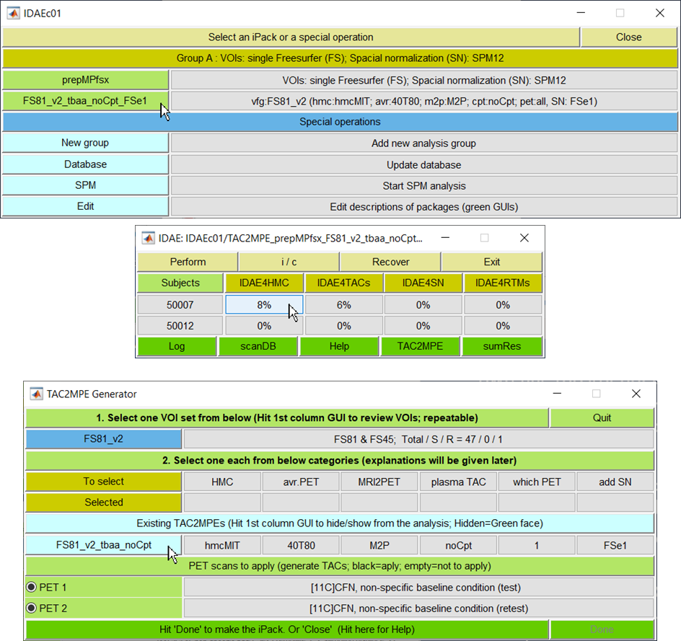
Starting Stage-2 Packages
Stage-2 Packages will be listed under group A (=prepMPfsx) when the project is revisited (upper panel)
Selections of options are listed on the right GUI in the order of selection items in TAC2MPE Generator (hmc, avr, m2p, cpt, pet, and SN)
Level 1 Window of the package (middle panel) pops up when it is selected
It may be a good idae to review individual blocks by opening them at this point
Newly generated Stage-2 packages will be listed in TAC2MPE Generator (lower panel) when the user revisit the TAC2MPE routine

Slide 40
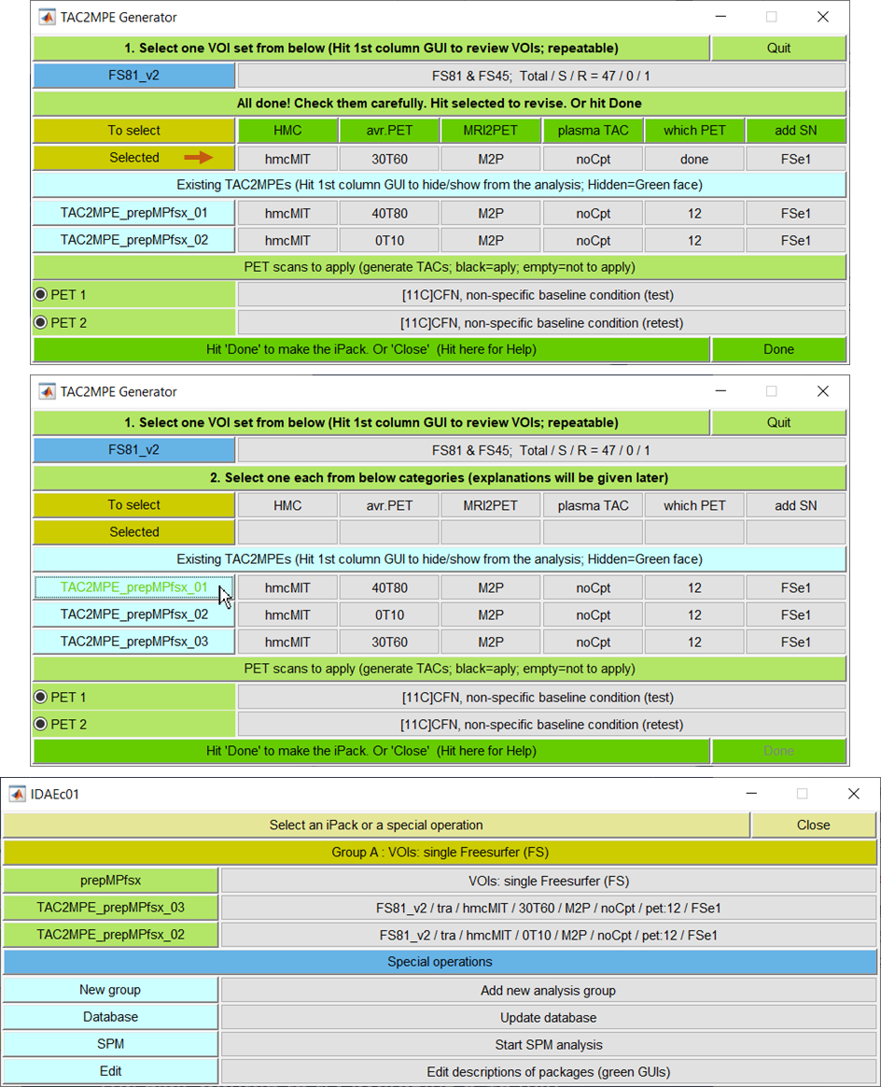
Managing Stage-2 Packages
It is very common to have several Stage-2 packages. IDAE
Major reasons for multiple Stage-2 packages:
Revisions of VOIs to refine / define (‘S’ and ‘R’ VOIs). Newly added VOI sets will be listed under current FS81_v2
Changes in any of option items
Explanation by example (totally hypothetical)
The user wanted to try averaging 0-10 min frames (0T10) for PET-to-MRI coregistration. The resulting package was ‘TAU2MPE_prepMPfsx_02’ since this is the second package
Later, the user wanted to try 30T60 to see if this performed any better than 40T80 (upper panel)
Now, the user has 3 Stage-2 packages (lower)
Comparing results from the 30T60 and 40T90 sets, the user chose not to use the 40T90 set
Hit the tab to remove (arrow, lower panel). It toggles between green (disabled) and black (enabled) face colors.
Disabled package will not show on the selection of packages (no 01 package, lower panel)
Apply the same procedures to any types of changes (i.e., major reasons), if any

Slide 41
Carrying on with TAC2MPE (a.k.a., Stage-2 Packages)

Slide 42
Automatic Processes of TAC2MPE with HMC
Frame-by-frame head motion correction using SPM12’s coregistration module with the user-selected cost function (optional)
Coregistration of PET to the MRI:
Averaging PET frames as selected during the generation of TAC2MPE
PET-to-MRI coregistration with SPM12’s coregistration module
In the QC process, the gray matter outlines from the MRI are projected on the averaged PET volume (See ‘Coregistration QC @IDAE4TACs)
If the coregistration is not acceptable, the user can displace the GM outlines to fit with gray matter of the PET volume to repeat the coregistration using the current guesses as the initial guesses for the optimization process
Generation of regional TACs:
Specified VOIs will be transferred from the MRI to PET spaces according to the PET-to-MRI coregistration parameters, and applied to successive PET frames to obtain regional TACs
Spatial normalization of the MRI
All spatial normalization processes will be performed the unified segmentation method of SPM12
In the QC process, the gray matter outlines in the MNI space (generated using the probabilistic maps of spatially normalized gray matter VOIs) are projected on the spatially normalized MRI of the subject
No correction measures are available. The user can eliminate the subjects with failed spatial normalization
Lastly, perform MPE and summarize results.

Slide 43
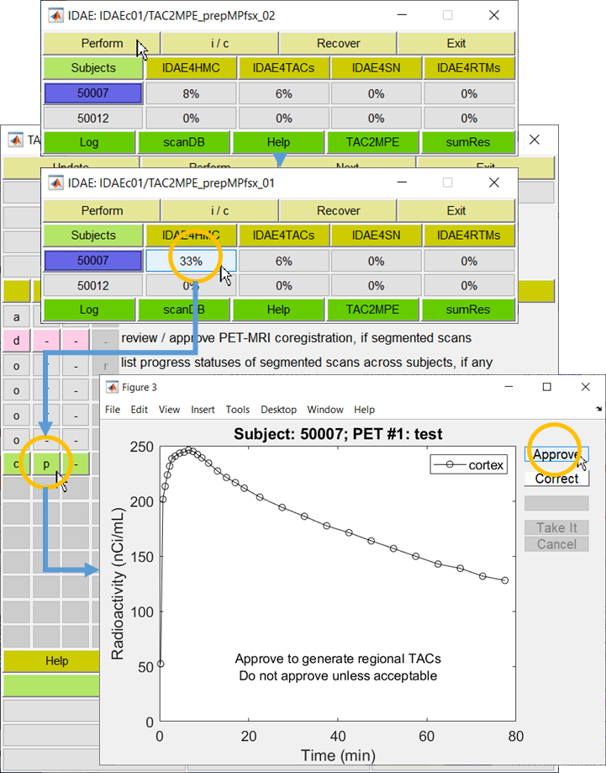
TAC2MPE with HMC
Just follow the principle of IDAE-managed analyses: Perform automatic processes first
Highlight the subject to perform (upper panel) and hit ‘Perform’ GUI (arrow)
In this case, frame-by-frame head motion correction will be performed using SPM12’s coregistration module with the specified cost function
When done, visit the first subject x analysis-base GUI with an increased completion status % (orange circle at 33%)
Look for the first light green GUIs with ‘r’ (=ready) or ‘p’ (=pending). Hit it
The plot of mean cortex TAC will appear
Approve it, if the TAC is reasonably smooth
No further correction measures at after HMC except removing the last (or a few last) frames.
The ‘d’ process (special processes that are applicable to certain cases) are not applicable without ‘correction’ approaches for the scans with ‘interrupted’ or ‘segmented’ frames
Once the QC process is done, repeat processing automatic processes
Note that IDAE4SN (spatial normalization) will be processed as well since the block involves MRI alone

Slide 44
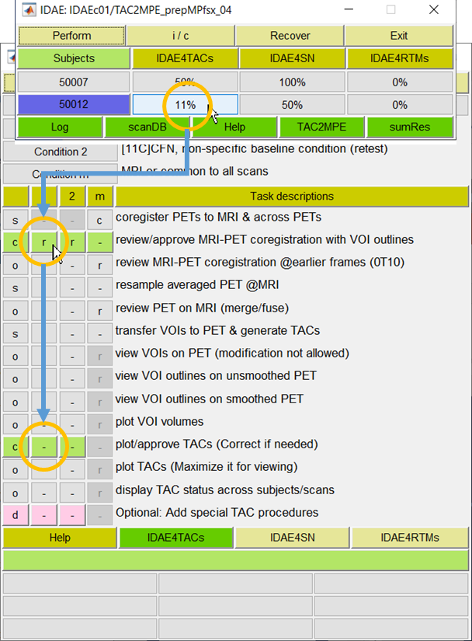
TAC2MPE without HMC
TAC2MPE without HMC is identical in the core structure to the version without HMC except that this version lacks IDAE4HMC
Again, just follow the principle of IDAE-managed analyses
Perform available automatic processes
Visit the first subject x block GUI what is expected to have an interactive process (upper)
Visit the first light-green GUIs displaying ‘r’ (middle circle)
Then, the QC process of PET-to-MRI coregistration opens (the same as the next slide)
When it is done, hit ‘Perform’ GUI in L1W.
Then the second row of light-green GUIs (lower circle) will show ‘r’ (See the slide of ‘Review/approve regional TACs’ downstream)

Slide 45
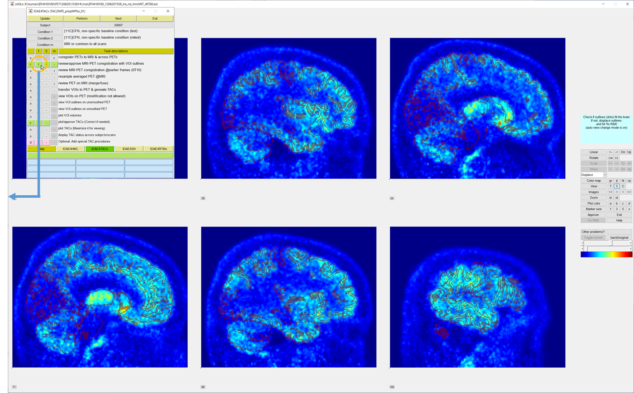
Coregistration QC @IDAE4TACs
Evaluate if the outlines of gray matter (from MRI) agree with gray matter of the averaged PET volume
Use T (trans-axial), S (sagittal), and C (coronal) GUIs under ‘view’ to change views.
Use arrow GUIs under ‘Images’ to navigate ‘slices’

Slide 46
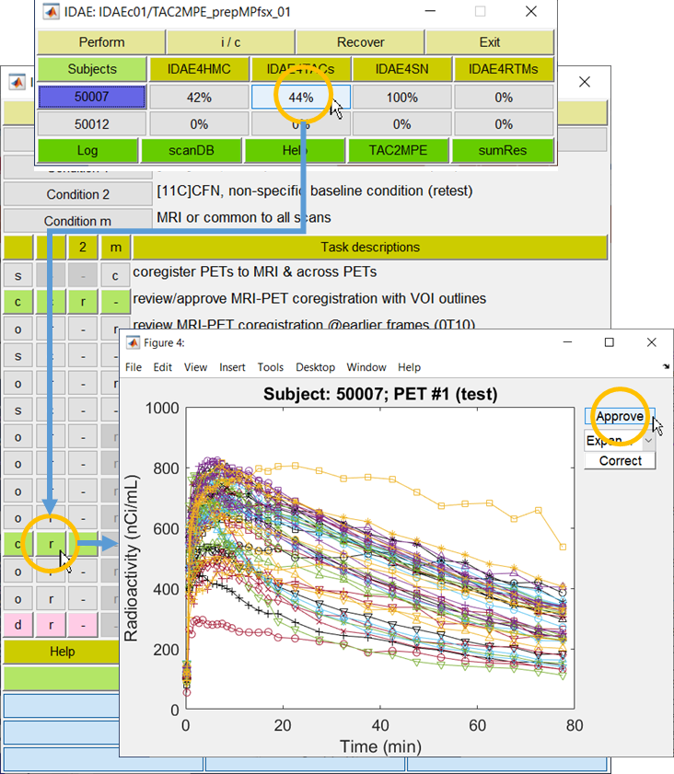
Review/Approve Regional TACs
Again, hit the first subject x block GUI with ‘increased’ completion status % (orange circle), and visit the first QC (light green) GUI with ‘r’ (or ‘p’) on it.
Then, plots of regional TACs will pop up
Approve it if TACs look OK (orange circle)
‘Correct’ GUI has no functions at this stage
Users can set regions to display. See the next slide for the procedure

Slide 47
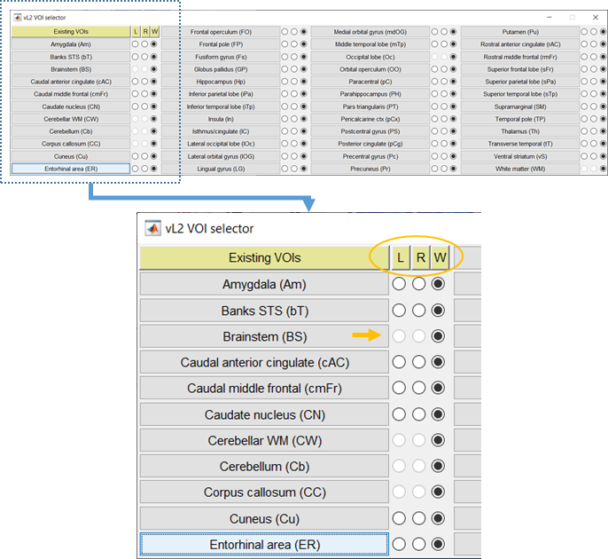
Using VOI Selector Module
The VOI selector module pops up together with plots of regional TACs
Users can control which regions to include the plots via the VOI selector module:
Anatomical labels of all available VOIs are listed in 4 primary columns
Each primary column (the first column magnified) lists 3 secondary columns for the left (L), right (R), and whole (W; left-right merged) regions (orange circle)
The columns of L and R are disable for those VOIs that are defined for the left-right merged VOIs alone, as for the brainstem (orange arrow)
Current selections are checked (black fill)
Users can change the selection statuses by clicking on the checkboxes
Users can change the statues of all regions of respective categories using ‘L’, ‘R’, and ‘W’ GUIs

Slide 48
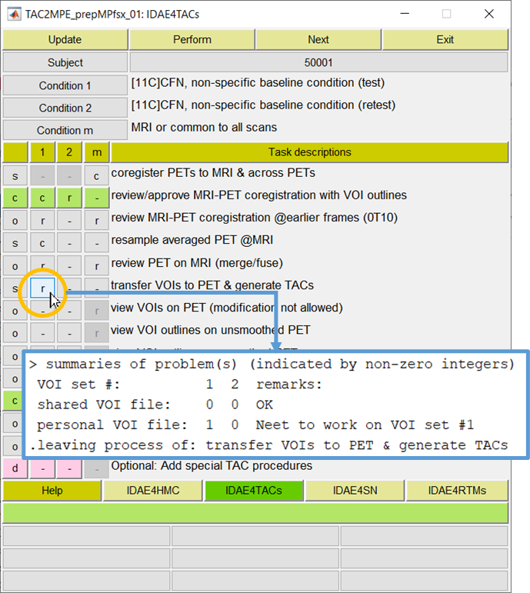
When TACs Are Not Generated
After performance of automated regions, the step of ‘transfer VOIs to PET & generate TACs’ could remain incomplete (‘r’ is ready to perform). Two major reasons for such instances
The mean cortex TAC has not been approved for the scan.
That may not be the case if the MRI-to PET coregistration is performed (in this case)
Not all VOIs od specified VOI sets are not ready.
Users will get a summary of the problems IDAE found for the VOIs in MATLAB command window (insert)
Two types of VOI files
Shared VOI sets: VOIs that are straight from Freesurfer and shared by local users. Only local manage is allowed modify defective VOIs.
Personal VOI sets: User-defined ‘S’ or ‘R’ VOIs. The user must complete them as ‘complete’ or ‘as good as possible to be used for VOIs. Shared VOIs will be used for non-‘S’ or ‘R’ VOIs.
Revisit the steps of define/define VOIs to complete ‘S’ and ‘R’ VOIs and revisit this step.

Slide 49
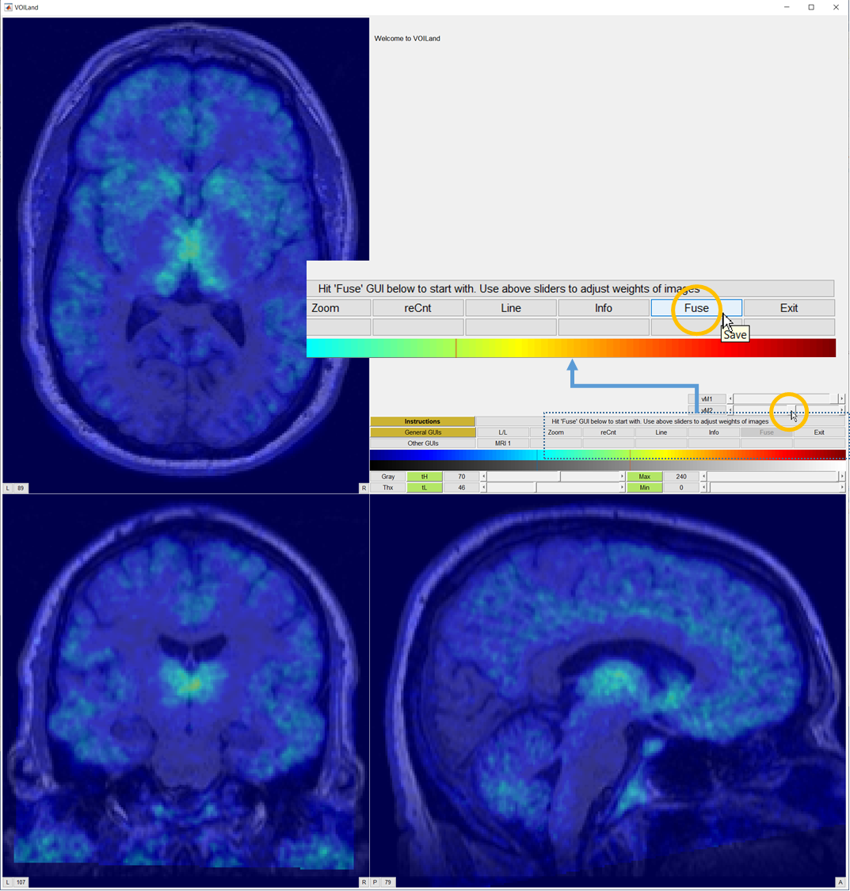
Optional Processes of IDAE4TACs
Feel free to visit optional processes (‘o’ in the first column)
Review PET on MRI (merge/fuse)
Aim: To display the averaged PET images on the MRI for visual inspection.
Procedures: Hit ‘Fuse’ GUI (upper circle), and adjust intensities of the MRI (upper slider) and PET (lower slider, lower circle)
Image navigation:
Hit at any point on a image to display orthogonal images through that point
Hit up/down, i/m (next to u/n), and </> keys to navigate cranium/neck, inion/nasion, and left/right directions, respectively
Hit ‘q’ key to navigate 30 images in the current direction: e.g., ‘u’ then ‘q’ to navigate 30 images toward the cranium
Display TAC status across subjects/scans

Slide 50
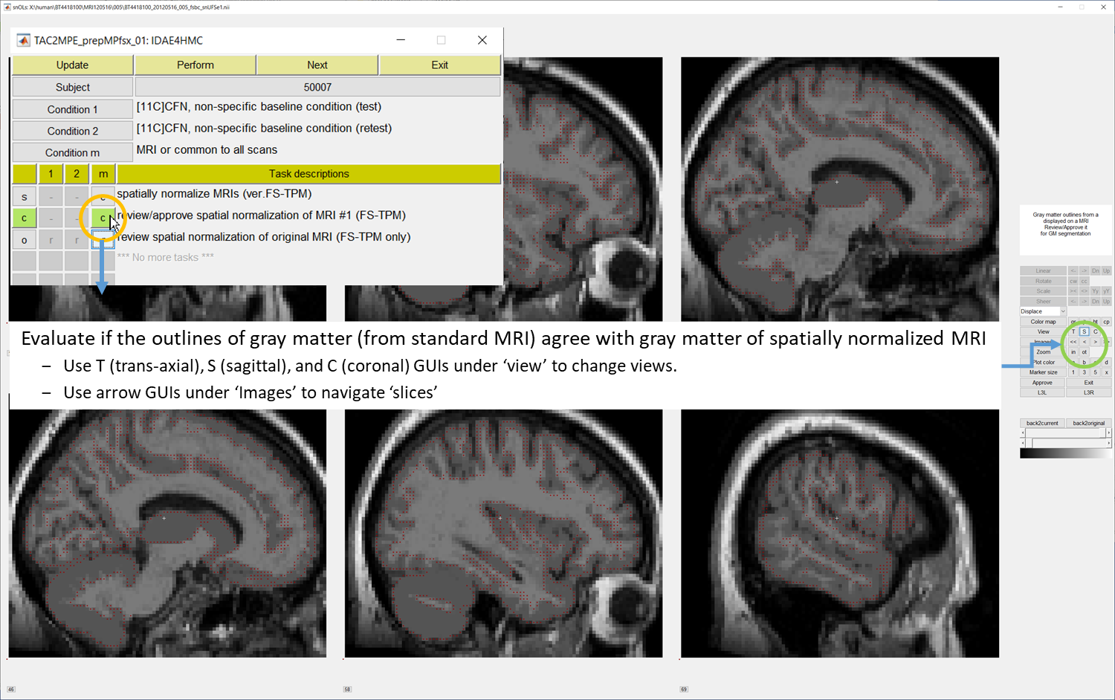
QC of Spatial Normalization @IDAE4SN
Freesurfer-defined gray matter is inserted in this version of MRI. Visit the next step to display SN’ed original MRI

Slide 51
To Set / Perform RTMs

Slide 52
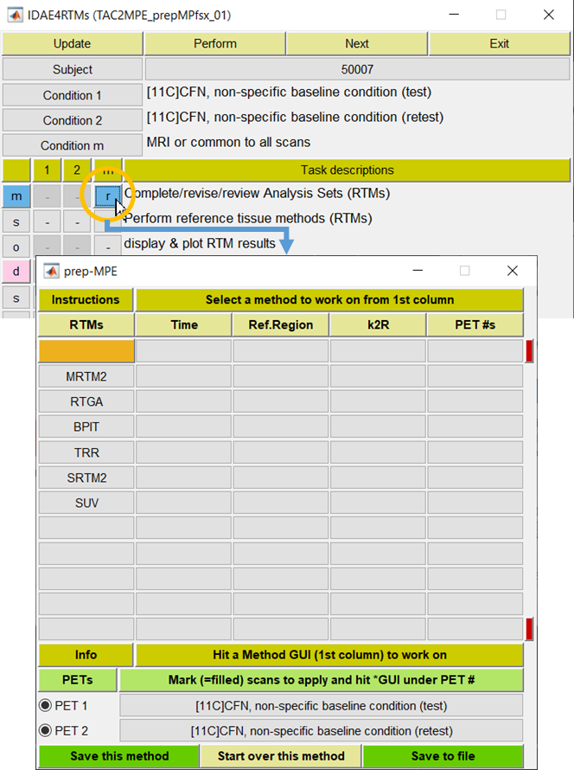
Setting RTMs: Overview
Aim: To set reference tissue methods (RTMs) and their parameters for the package
Major procedures:
First, set the MPE preparation module (lower panel) by clicking the designated GUI (orange circle; upper panel)
Follow instructions given in the 1st row
Bring in a method from the 1st column GUIs to set relevant parameters (2nd to 4th columns)
See the quick guide (next slide) for methods
Hit ‘Save this method’ (bottom left) when done to move on to the next method
Go inclusive in the first cycle (i.e., for all PETs) to be selective in the second cycle.
Hit ‘Save to file’ if no more methods to set (= the end of the first cycle)
Visit already-selected (light green) methods one-by-one in the second cycle
Adjust applicable PET sans and hit ‘Save this method’ to move on to the next method
e.g., 20T90 for PET 1 (tracer A) and 40T90 for PET 2 (tracer B) for PRGA
Hit ‘Save to file’ when all methods are done (= the end of second cycle)

Slide 53
RTMs: Quick Guide
Methods | Explanations
MRTM2 | Multilinear reference tissue method with 2 parameters (Ichise et al., 2003) Treatment of k2R (k2, the brain-blood clearance constant of the reference region): Median k2R: Use the median values of k2R (across regions) from the 3-parameter fit Optimize: Optimize k2R by minimizing the total RSS across regions. Referred to as optk2R here. Fix as RTGA: fix k2R at the user-entered k2R value(s) for PRGA (need to set)
RTGA | Reference tissue graphical analysis (Logan et al., 1996) RTGA will be performed in two ways: Fixing k2R at the user-entered k2R value(s), and optimizing k2R by minimizing the total RSS across regions (Referred to as optk2R)
BPIT | Bolus-plus-infusion transformation (Kuwabara et al., 2013)
TRR (SUVR) | Target-reference tissue ratio
SRTM2 | Simplified reference tissue method with 2 parameters (Lammertsma and Hume, 1996) Not recommended by IDAE because SRTM2 yields practically identical values of BPND to MRTM2, while computationally more demanding. Wu and Carson, 2002 should be credited for the 2 parameter version
SUV | Standard uptake value
On the circulation times for data analysis
IDAE’s t*TT_{end} Format | All RTMs assumes the conditions for a method are met a segment of the total scan from the start-analysis time (denoted by t*) and the end-analysis time (T_{end}). In IDAE, the start- and end analysis can be specified by a t*TT_{end} format (e.g., 20T80 for a t* of 20 min, and an end-analysis time of 80 min)

Slide 54
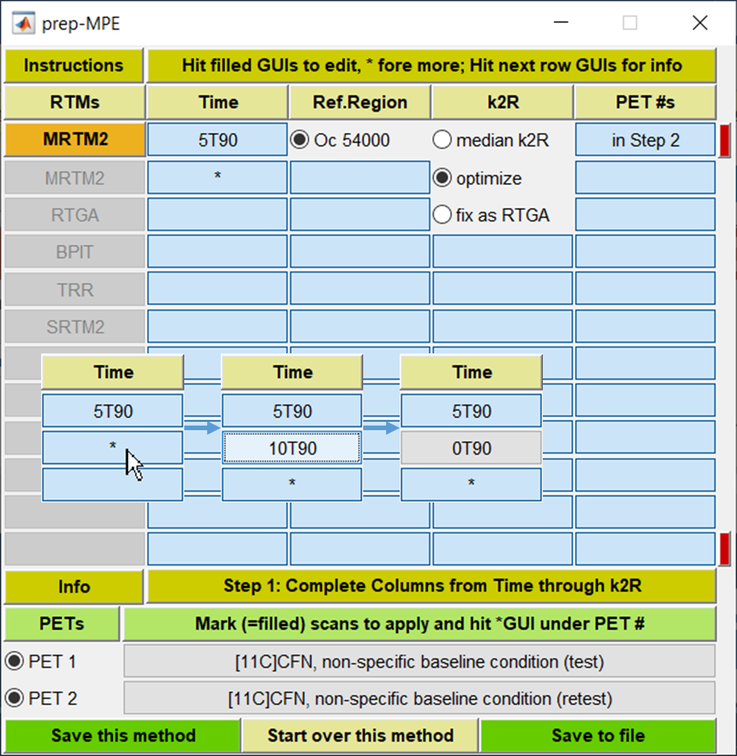
Setting MRTM2: First cycle
Hit MRTM2 to start with.
MRTM2 will be shown in the orange GUI while GUIs for other methods are disabled
Default parameters will be shown initially. Users can modify them as needed as follows:
Time: the circulation time for the analysis in startTend format: 5T90 to use 5-90 min frames
Hit an available GUI (5T90 initially) to modify it. The GUI becomes editable. Enter your values and hit ‘enter’ to quit the editable mode.
Hit the GUI with * (arrow in left insert) to set another circulation time (by the start time increase by 5 min; thus 10T90) (middle insert)
Hit the GUI to modify it as show above. And hit return when done (right insert)
Reference region: Pre-selected reference regions (‘R’ regions) will appear here.
Go inclusive in the first cycle. For example, select all reference regions when reference regions differ among tracers of the scans (PET 1, 2, etc.).
See ‘Quick Guide’ for k2R
all checked will be performed
Need to add RTGA if to use the ‘fix as RTGA’ option
Hit ‘Save this method’ GUI when done

Slide 55
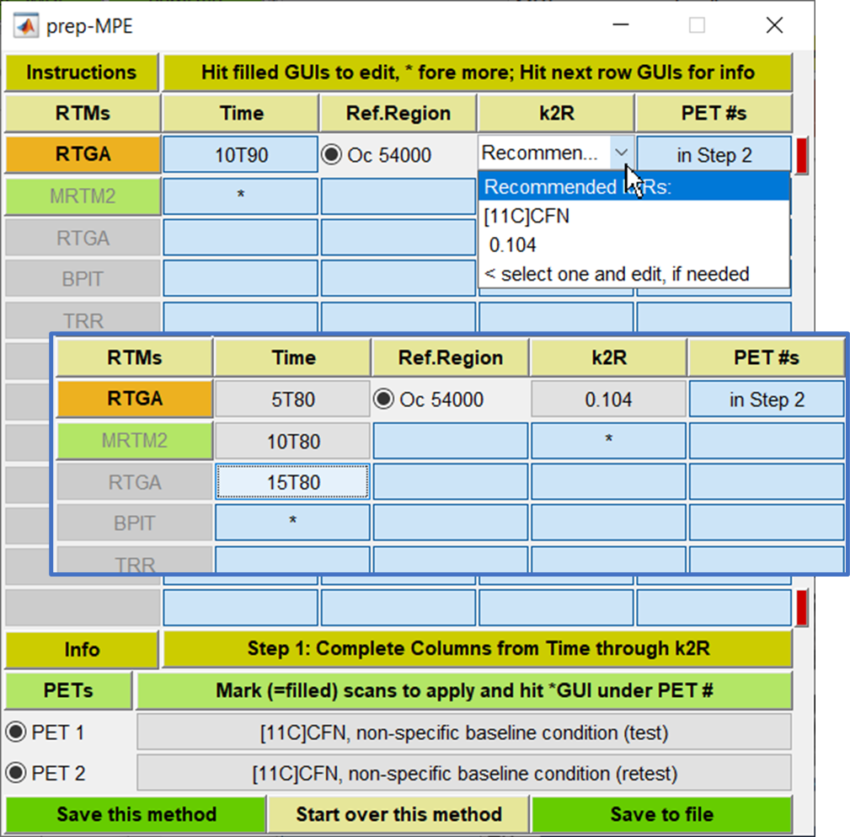
Setting RTGA: First Cycle
Hit RTGA to start with
MRTM2 which was set in the previous slide is marked by light green, although it is disabled along with other non-RTGA methods
Default parameters are shown initially
The values of k2 of the reference region (k2R) must be provided for RTGA. Users can:
Use IDAE-recommended values, then edit them if needed
If the value is unknown yet, run MRTM2 and obtain mean k2R across subjects
When the study involve multiple tracers of different k2R values, enter all in the first cycle and make them tracer-specific in the second cycle
An example of RTGA setting is shown in insert
Three values for t* (the start of asymptote for RTGA plots) were set to examine which t* is appropriate to [11C]CFN
Hit ‘Save this method’ GUI when done
If no more RTMs to define, hit ‘Save to file’ GUI

Slide 56
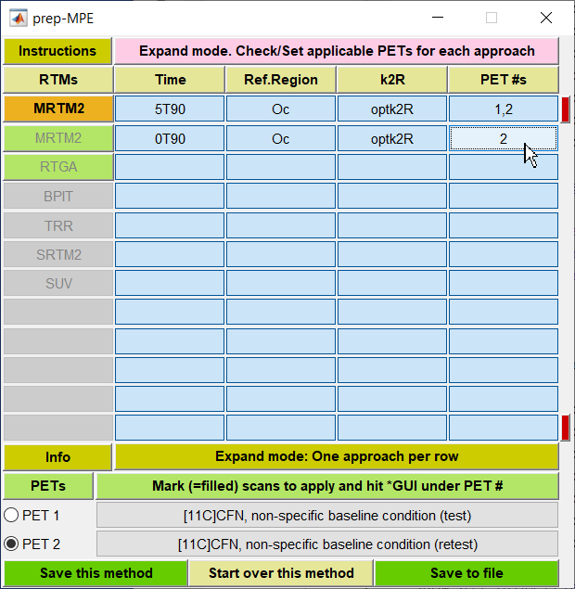
Setting MRTM2: Second Cycle
Assume that ‘Save to file’ GUI was hit after setting MRTM2 and RTGA
Then, the module goes into the second cycle (pink instruction GUI)
Select a method among green GUIs (MRTM2 in this case)
Now each line shows one set of MRTM2 analysis
Making analysis set scan-specific (tracer-specific in fact):
Note that we cannot do much for making analysis sets to be tracer-specific in this study because the tracer is the same for PET 1 and 2
Assume (although very hypothetical) that the 0T90 set is applicable to PET 2 alone. Then, unmark PET 1 alone (orange circle), then hit a GUI under ‘PET #s’ (arrow). It turns now that the 0T90 analysis is ‘applicable to PET 2 alone’
Hit ‘Save this method’ when all rows are OK
Note that the GUI of MRTM2 turns to a darker green color indicating that the second cycle is done for MRTM2

Slide 57
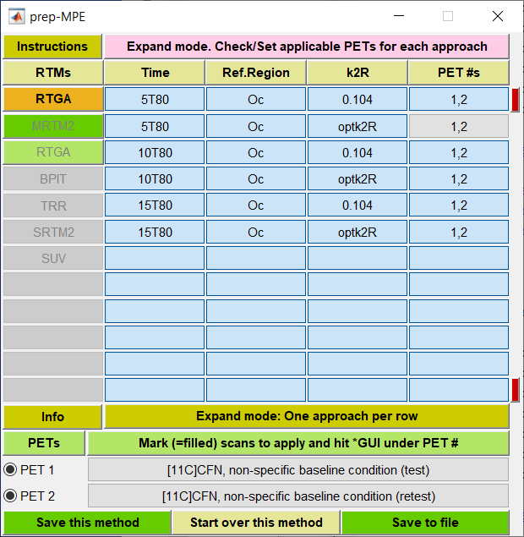
Setting RTGA: Second Cycle
Again, each row lists an analysis set of RTGA in the second cycle.
In this example, 6 analysis sets will be performed: 3 user-entered analysis circulation time sets x 2 k2R sets (to fix at 0.104 and to optimize the value for the scan which is automatically added by IDAE).
Note that we cannot do much in terms of making analysis sets to be tracer-specific in this study because the tracer is the same for PET 1 and 2
Hit ‘Save this method’ when all rows are OK
Note that the GUI of RTGA turns to a darker green color indicating that the second cycle is done for PRGA
Hit ‘Save to file’ GUI if there are no more ‘light green’ GUIs. This is the end of RTM setting.

Slide 58

Further on the 2nd Cycle: 1
In the 1st cycle of this example:
Four t*, the starting time for MRTM2 were entered (but all ending at 90 min)
One reference region was entered (CW or the cerebellar white matter)
Two approaches for k2R, k2 of reference region were entered
Median k2R in which median of regional k2R values from MRTM3 will be obtained / fixed in MRTM2 (original MRTM3 and MRTM2)
Optimize k2R to minimize the total sum of square sums across regions (modified MRTM2)
Altogether, 12 modeling approaches (= 4 x 1 x 3) are specified in the 1st cycle
In the 2nd cycle:
The 12 modeling approaches will be listed one per row
Page up / down GUIs (red GUIs) will be activated when more than 12 approaches are present.
Since this is a one-scan study, the role of the 2nd cycle is limited to just confirm presence of individual modeling approaches.
See the next slide for multi-PET a study

Slide 59

Further on the 2nd Cycle: 2
In the 1st cycle (not shown) of this example:
Two circulation time pairs were set for RTGA (20T90 and 25T75)
One reference region was entered (Cb or the cerebellar)
Two approaches for k2R, k2 of reference region were entered
Two fixed k2R values for PIB and DASB (0.149 and 0.48 min⁻¹, respectively) were entered
Optimize k2R by minimizing the total sum of square sums across regions (denoted as optk2R)
Altogether, 6 modeling approaches (= 4 x 1 x 3) were specified for RTGA in the 1st cycle
Set the applicable PETs in the 2nd cycle:
The 6 modeling approaches will be listed one per row to be applicable to all scans (1, 2, 3, and 4) initially (upper panel)
Now set the applicable scans for PIB scans
Deselect PET 3 and 4 (bottom PET area)
Hit GUIs of the rows of k2R = 0.149 min-1 under ‘PET#s’ (e.g., at the cursor) to change applicable PET scans to all to 1 and 2
Repeat the same procedures for DASB after activating PET 3 and 4 alone

Slide 60

Perform / Review RTMs
It is very simple to perform RTMs
Just highlight subjects to perform RTMs (judged from completion status) and hit ‘Perform GUI (lower insert)
Once the automatic processes are done, the completion statuses increase (upper insert)
Users can review results of RTMs of a subject as follows
Visit the subject x block GUIs (under IDAE4RTMs) of any subject to open L2W
Hit ‘r’ GUI (orange circle) @’display & plot RTM results’

Slide 61

Display / Plot RTM Results
Hit the ‘r’ GUI @’Display / plot RTM results’ of L2W (IDAE4RTMs) to set the result display module (background)
Select an output from the menu (top right)
Display regional values … (shown here)
Scatter plot of regional data of a variable between scan 1 vs. scan 2 and so on
Line plots vs. regions: Spaghetti plots
Select one analysis approach from the list (left insert)
Approaches are shown by 5 elements of ‘method flag’ (acronyms), ‘circulation time for analysis’, ‘acronym of reference region’, ‘treatment of k2R’, and ‘primary variable’.
Select the variable to display (middle insert)
Select ‘show all variables’ to display them all
Select the scan to display (right insert)
Light green = available; darker green = selected
Set the VOIs to display (bottom)
See the section of the VOI selector module
Hit ‘Perform’ GUI (bottom left)

Slide 62

Example of Observed and Fitted TACs: MRTM2
Plots of observed (o) and model-fitted (-) TACs of all left-right merged regions

Slide 63

Revise / Review RTM Approaches
First, hit ‘c’ GUI at ’Complete/revise/review Analyses Sets’ of L2W to bring up the MPE preparation module (upper panel)
Previously set RTM approaches will be highlighted in light green
Hit a highlighted approach to review / revise
Bring in / set a new approaches, as needed
Hit ‘Save this method’ to update the working approach
Hit ‘Save to file’ when all approaches are done (= the end of the 1st cycle)
Leave those approaches not intended to review / revise unattained
In the 2nd cycle (lower panel):
Hit a highlighted approach to review / revise
Hit ‘Save this method’ to update the approach
Reviewed / revised approaches will be highlighted in darker green (MRTM2 in this example)
Hit ‘Save to file’ when done (= the end of the 1st cycle)
Leave those approaches not to review / revise unattained

Slide 64
To Prepare Plasma and HPLC Data

Slide 65

Preparation of Plasma & HPLC files
When the ‘preparation’ step is activated (upper orange circle), L2W’s utility GUIs will be set for the purpose (orange rectangle)
The function of ‘Plasma’ GUI is to prepare a file of plasma data of this scan of the subject
Here, the term ‘plasma data’ refer to a two-column matrix of sampling times and radioactivity values in user-specified unit
The function of ‘HPLC’ GUI is to prepare a file of HPLC data
The term ‘HPLC data’ refers to a two-column matrix of sampling times and fractions of metabolites in percentage
The ‘Plasma’ and ‘HPLC’ GUIs will not function until the local manager set the local system file (dxetc4xxx.m)
This is to cope with the fact that individual PET centers or Labs prepare plasma and HPLC files in their own formats and store them according to their own conventions.
To local IDAE managers:
See help messages from cv2_getCPT.m
See also the next two slides

Slide 66

Site-Specific Operations: Plasma
In this example, MATLAB’s file selector will pop up when ‘Plasma’ GUI is hit.
Note that the folder was pre-selected
Files of target format (*.xls*) alone are listed
When the target file is selected (lower orange circle), the plasma data will be extracted and saved in IDAE-requested format
The GUI will be marked in darker green
Use ‘Restart Plasma’ GUI to start over
To local IDAE managers:
The callback function of ‘Plasma’ GUI is:
dxetc4xxx(‘get_plasma’,input_2)
where input_2.ofl contains the IDAE-generated output plasma file, and input_2.fbc lists [figure # of L1W, subject #, scan #]
Set a subfunction ‘local_get_plasma’ in your dxetc4xxx.m and set the following measures:
To find the plasma file. A MATLAB function of uigetfile.m was utilized in this example
To convert the plasma data into a two-column matrix of sampling times and radioactivity values in user-specified unit
To save it to input_2.ofl in 8-digit ASCII format (add ‘-ascii’)
To update the Plasma GUI (to green) add the following line just after the ‘save’ line
cv2_getCPT(‘check’, 1)

Slide 67

Site-Specific Operations: HPLC
In this example, MATLAB’s file selector will pop up when ‘HPLC’ GUI is hit.
Open the target PDF file (lower panel) as shown in previous slide. Copy / paste time and parent fractions to the MATLAB command as instructed therein
The manual method was selected since the function to read PDF requires a specific MATLAB toolbox
The GUI will be marked in darker green
Use ‘Restart HPLC’ GUI to start over
To local IDAE managers:
The callback function of ‘Plasma’ GUI is:
dxetc4xxx(‘get_hplc’,input_2)
where input_2.ofl contains the IDAE-generated output HPLC file, and input_2.fbc lists [figure # of L1W, subject #, scan #]
Set a subfunction ‘local_get_hplc’ in your dxetc4xxx.m and set the following measures
To find the HPLC file. A MATLAB function of uigetfile.m was utilized in this example
To convert the plasma data into a two-column matrix of sampling times and radioactivity values in user-specified unit
To save it to input_2.ofl in 8-digit ASCII format (add ‘-ascii’)
To update the HPLC GUI (to green) add the following line just after the ‘save’ line
cv2_getCPT(‘check’, 2)

Slide 68

Correct for Radioactive Metabolites: 1
The setCPT module will pop-up with plot of the plasma TAC (total) (lower panel) when the GUI of the ‘correct ..’ step is clicked (orange circle)
Observe the plasma TAC
Some corrective measures for the plasma TAC are provided (left insert; under Ca(t))
Consult the tabs for functions
sumExp2/3 refer to sums of exponential functions
Import HPLC data, if plasma TAC is OK

Slide 69

Correct for Radioactive Metabolites: 2
Observe plot of the HPLC data (blue circles in lower panel)
Note that the HPLC data show total metabolites in percentages (= 100 – parent fraction in percentage)
Fit the HPLC data by one of IDAE-supplied functions (3rd tab and on; upper panel)
The IDAE team suggest using ‘mixed’, ‘fitHPLC’, one of ‘fitHPLCH*’, or ‘pchip’
‘pchip’ refers to the shape-preserving piecewise cubic interpolation of MATLAB (interp1.m)
Employ one approach across scans of a study
Hit ‘Take’ (lower orange circle), ‘Apply’, and ‘Approve’ GUIs sequentially. It’s done!
Associate the fitting approaches with the IDAE-supplied generic terms for plasma data
The generic terms including ‘noTAD’ and ‘HPLC*’ are presented during generation of Stage-2 packages (TAC2MPE)
The IDAE team recommends to make site-wide rules, for example to use ‘noTAD’, ‘HPLC’, and ‘HPLC1’ for ‘fitHPLC’, one of ‘fitHPLCH*’, and ‘pchip’, respectively.

Slide 70
To Set / Perform PIMs

Slide 71

Setting PIMs: Overview
Aim: To set plasma input methods (PIMs) and their parameters for the package
Major procedures:
First, set the MPE preparation module (lower panel) by clicking the designated GUI (orange circle; upper panel)
Follow instructions given in the 1st row
Bring in a method from the 1st column GUIs to set relevant parameters (2nd to 4th columns)
See the quick guide (next slide) for methods
Hit ‘Save this method’ (bottom left) when done to move on to the next method
Go inclusive in the first cycle (i.e., for all PETs) to be selective in the second cycle.
Hit ‘Save to file’ if no more methods to set (= the end of the first cycle)
Visit already-selected (light green) methods one-by-one in the second cycle
Adjust applicable PET sans and hit ‘Save this method’ to move on to the next method
e.g., 20T90 for PET 1 (tracer A) and 40T90 for PET 2 (tracer B) for PRGA
Hit ‘Save to file’ when all methods are done (= the end of second cycle)

Slide 72
PIMs: Quick Guide
Labels | Descriptions | Parameters | Outcome Variables
OTCM | One tissue compartment model | K₁, k₂’, V₀ | V_{T} = K₁/k₂’
TTCM3 | Two tissue compartment model irreversible (no k₄) | K₁, k₂, k₃, V₀ | K_{i} = K₁·k₃ /(k₂ + k₃)
GPGA | Gjedde-Patlak plot | Slope of asymptote | K_{i} : slope
TTCM4 | Two tissue compartment model reversible (with k₄) | K₁, k₂, k₃, k₄, V₀ | V_{T} = K₁/k₂ (1 + k₃/k₄) BP_{ND} = k₃/k₄?
TTCM4C | TTCM with the K₁/k₂ ratio fixed at the reference tissue value | K₁, k₃, k₄, V₀ | V_{T} = K₁/k₂ (1 + k₃/k₄) BP_{ND} = k₃/k₄
PRGA | Plasma reference graphical analysis (Logan et al., 1990) | Slope of asymptote | V_{T}: Slope BP_{ND} = V_{T}/V_{T}^{R} - 1
MA1 | A multi-linear version of PRGA
BPITp | Bolus-plus-infusion transformation |  | V_{T}: Plateau height
K₁, k₂:BBB clearance constants; k₃ = B_{max}/k_{on}; k₄ = k_{off}; V₀: tissue vascular volume
TTCM3 etc (yellow highlight): Not working for now (need to fix by submission)

Slide 73

Setting PIMs: General Points
Hit a method to set (OTCM in this example)
The method will be shown on the ‘Orange’ GUI
Suggested entries will be shown in columns of ‘Vas. volume’, ‘Time’, and ‘Initial guesses’
Complete columns:
Hit a filled GUI to modify it, as needed
The GUI turns in the ‘edit’ mode (pink)
Follow the displayed format: e.g., for the initial guesses, enter ‘K1 = new value, k2 = new value’
Empty it to remove the entry
Hit the ‘return’ key when done (no longer in pink)
Hit a * GUI to create a new entry (orange circle)
The GUI turns in the edit mode (pink) with a new suggested entry (insert)
Follow the displayed format: e.g., ‘fix new value’ to fix the vascular volume at the new value
Empty it to remove the entry
Hit the ‘return’ key when done (no longer in pink)
Hit ‘Save this method’ GUI when it is done for the method.
Hit ‘Save to file’ GUI when all intended methods are done
Repeat the same in the second cycle to individualize the methods to scans

Slide 74

When to Employ TTCM4 Family
See the ‘Quick Guide’ to know IDAE’s acronyms for PIMs
IDAE is set to perform TTCM4 & TTCMC4 with regionally adjusted initial guesses of parameters, if OTCM and PRGA are also performed
Initial guesses of K₁ through k₄ will be calculated from the estimates of K₁ from OTCM (with a short circulation time such as 0T20) and estimates of V_{T} from PRGA.
In our experience, the measure decreased # of outliers of V_{T} (e.g., > x5 of the maximal regional V_{T} value from PRGA)
Thus, IDAE chose to adopt the feature.
In sum, set OTCM and PRGA if the user intend to set TTCM4 and/or TTCMC4

Slide 75
Setting OTCM: First Cycle
Vas. Volume: vascular volume in tissue v₀.
Default (initial suggestion): ‘fit 0.035’ to fit v₀ while setting the initial guess to 0.035 mL/mL
‘fix value’ is also valid to fix v₀ at the value (e. g., 0.035 mL/mL)
Enter ‘fix 0’ to ignore the vascular volume in tissue
Circulation time:
Start- and end-frame time of the analysis
Use the startTend format
The initial suggestion is ‘0T20’ specifying to use 0-20 frames for the model parameter estimation
This is to obtain regional values of K1 because OTCM can fit TACs very well if initial 20 min of the scan is use (see ‘When to Employ TTCM Family’)
Add other sets (e.g., 0T90) to test OTCM in longer scan durations.
The start-frame time should be 0 in OTCM
Initial guesses:
The generic one (K1=0.3, k2=0.2) should work well for OTCM
‘Save this method’ to move on to set the next method
*Second (or more) entries for ‘fit’ and ‘fix’ of ‘vas. volume’ (e.g., ‘fix 0.03’ and ‘fix 0.05’) and ‘initial guesses’ work only when they are made scan-specific in the second cycle (e.g., ‘fix 0.03’ for scans 1 & 2 and ‘fix 0.05’ for scans 3 & 4). Otherwise, second (and more) entries will be ignored (due to common output file names).

Slide 76

Setting TTCM4 and TTCMC4
Columns of ‘Vas. volume’ and ‘Time’ are accessible for TTCM
The entry, ‘OTCM+PRGA’ under ‘Initial guesses’ indicates that initial guesses of K1, k2, k3, and k4 are calculated from outputs of OTCM and PRGA
Columns of ‘Vas. volume’ and ‘Time’ are accessible for TTCMC4
Select applicable reference regions from the list
Filled = selected; empty = not to use
The K1-k2 ratio of the scan will be obtained from TTCM4 of the reference region to be fixed to estimate K1, k3, and k4 alone in other regions
Leave 0 of 0Tend (e.g., 0T90) for OTCM, TTCM4, and CCTMC4 because there is no justification for ignoring the initial portions of TACs in these methods

Slide 77

Setting PRGA, MA1, and BPITp
Complete the column of ‘Time’ alone for PRGA, MA1, and BPITp
Again, use the t*Tend format where t* stands for the start time of asymptotes and ‘end’ stands for the circulation time for the analyses
Hit the GUI with * to start a new entry
Edit it (in pink) as needed.
Hit an existing GUI to edit it.
Make sure to include PRGA if to employ TTCM4 or TTCMC4

Slide 78

Performing PIMs
To perform PIMs on this subject alone:
Hit ‘Perform’ GUI (top orange circle) of IDAE’s Level 2 window
Hit ‘r’ GUI of the designated task (middle orange circle)
To perform PIMs on multiple subjects:
Highlight subjects to perform on Level 1 window and hit ‘Perform’ (bottom orange circle)

Slide 79

Display / Plot PIM Results
Hit the ‘r’ GUI @’Display / plot PIM results’ of L2W (IDAE4RTMs) to set the result display module (background)
Select an output from the menu (top right)
Display regional values … (shown here)
Scatter plot of regional data of a variable between scan 1 vs. scan 2 and so on
Line plots vs. regions: Spaghetti plots
Select one analysis approach from the list (left insert)
Approaches are shown by 5 elements of ‘method flag’ (acronyms), ‘fit flag’ (e = to estimate; c = to fix; I = to ignore for K1, k2, k3, k4, and v0), ‘circulation time for analysis’, ‘acronym of initial guesses’, and ‘primary variable’.
Select the variable to display (right insert)
Select ‘show all variables’ to display them all
Select the scan to display (right insert)
Light green = available; darker green = selected
Set the VOIs to display (bottom)
See the section of the VOI selector module
Hit ‘Perform’ GUI (bottom left)

Slide 80

Example Fitting Plots: TTCM

Slide 81

Revise / Review PIM Approaches
To review / revise saved PIM approaches
Hit ‘c’ GUI at ’Complete/revise/review Analyses Sets’ to bring up the MPE preparation module (upper panel)
Previously set PIM methods will be highlighted in light green
Hit a highlighted method to review / revise
Bring in / set yet-set methods, as needed
Hit ‘Save this method’ to update displayed method
Hit ‘Save to file’ when done (= the end of the 1st cycle)
Leave those methods not to review / revise unattained
In the 2nd cycle:
Hit highlighted methods to review / revise
Hit ‘Save this method’ to update displayed method
Reviewed / revised methods will be highlighted in darker green (e.g., TTCM4 in this example)
Hit ‘Save to file’ when done (= the end of the 1st cycle)
Leave those methods not to review / revise unattained

Slide 82

Result Summary

Slide 83

Introduction
Aim: To make figures and tables for reports and manuscripts
One set of outputs (figures or a table) is defined in one cycle of actions that includes:
Selection of the output type
Available output types are listed on the menu bar (foreground, orange lines) of the disp.Res module (background)
Successive selections about details of the outputs, all done by GUIs
outlined in the tab, blue lines
Execution of so-generated commands
Management system:
IDAE adopt the following system to make it possible to re-generate outputs at will
The command lines from one cycle are stored as a ‘subsection’ in the sumRes.m file (plain text) of the study
Subsections are organized under sections, both with user-defined titles
The user choose where to place the new subsection in the file at the end of a cycle i.e., such as under which section and above or below which subsection

Slide 84

First sumRes Cycle
Hit the ‘sumRes’ (for result summary) GUI of L1W to start with
A designated file (referred to as sumRes.m) will be generated / opened
It will be organized by sections (start with $$$) which hold several subsections (start with #)
Initially, one each alone (second panel)
The user manage section/subsection titles while IDAE inserts executable contents
Examples of user-edited section and subsection titles are shown in the third panel
Make sure to save it before moving on.
Hit the ‘sumRes’ GUI one more time to display the sumRes module (bottom).
Select the section to work on first from the upper menu bar (headed by S# under orange arrow), then the subsection at SS# (subsection #)
Now the user is ready to add the executable contents (move on to the next slide)
Good to remember: Always start with the section first to update the section and subsection titles after revisions.

Slide 85

Before Setting Outputs
Hit ‘Add/modify’ of the sumRes module (top) to display the ‘Display Results’ (disp.Res) module (bottom, background)
The sumRes module indicates that the user is intended to add the executable content for the subsection of the section
In this example, ‘Scatter plot of VT: BPIT (=y) vs. PRGA’ under 'Method evaluation (RTMs)'
Read the instruction menu carefully
Available output types are listed at top under ‘Display a desired output’ (@cursor)
Each selection shows the type flag followed by simple description
Just display the intended output type
In this example, the user intends to make ‘XY plots’ according to the user-defined subsection title
At least one example each output category will be described in this manual.
Once the intended output type is selected, the main GUI matrix of the disp.Res module become available for selections (next slide)

Slide 86

Selecting Variables to Report: XY Plots
Once ‘XY plots’ is selected (top right), GUIs for x- & y-data become available (left column)
Use the row of 2nd var to specify relational variables such as differences, ratios, or occupancy estimates, as needed
Complete data lines, one line at a time from left to right (showing for ‘x-data’ first)
Select the primary method classification
The highlighted selection means ‘regional V_{T} value from this package’ (= VOI-based analysis)
‘Map-value from PIM (from this package) will become available when VT images were generated for this package.
Data from ‘other’ packages will become available if other packages are generated / processed
Select the method (middle foreground panel)
Not sure about the method identification format? Review sections of RTMs and PIMs
Select the variable to report (bottom left)
Select the groups to report and display ‘done’
No need to select groups to report all groups
Lastly, select the scans to report
Applicable PETs are shown by light green
Repeat the same for ‘y-data’

Slide 87

Setting Remaining Parameters: XY Plots
The user’s intention in this example (review):
To make a scatter plot of V_{T} data, BPIT (=y) vs. PRGA (@SS#1, upper panel) as a part of ‘model evaluation (@S#1 = section title)
Accordingly, it was set that V_{T} data of scan #1 of all subjects were used in the plot (middle panel)
Set the remaining parameters using bottom row GUIs of the disp.Res module:
Set VOIs to report (third panel, right)
It is recommended to set VOI sets using VOI selector module to be consistent among trials
Review the section of ‘Setting a New VOI Set’
A previously prepared VOI set was used here
Set output options (bottom panel)
Each selection shows the option flag followed by simple description
Most descriptions are self-explanatory. But ..
Need to replace r (=# of rows) and c (=# of columns with integers in sumRes.m when to use subplot[r,c] (subplot[3,4] will display 3 rows x 4 columns of subfigures in one figure window.
Multiple options may be selected, as needed (denoted by *, as the user select)
Lastly, specify where to place the executable lines
Select #5 for this example because both section and subsection titles are present (top panel)

Slide 88



Setting a New VOI Set
The users can define a VOI set when the ‘display result’ module is in the result summary mode.
Select the ‘set a new VOI set’ tab under ‘VOIs’
Check the VOIs to include in the new set: L/R/W GUIs for bulk operations of the left, right, and whole (i.e., left-right merged) VOIs, respectively; Hit a checkbox to set it ‘on’ (filled) or ‘off’ (blank) one-by-one
Empty the tab (Set a VOI set? …) and enter a concise name. Note that the name of current VOIs set (FS81_v2) will be prepended automatically (i.e., All_w_noWM alone was entered in this case)

Slide 89

Generation of XY Plots
Once ‘Save’ is done, ‘Not-right’ GUIs blinks in pink on the disp.Res module
Make corrections until the sumRes.m is updated
If successful, the executable lines will be inserted to the sumRes.m file (and opened)
No need to check the executable lines (it’s IDAE’s responsibility)
The user can add command lines (second panel) for make-up
In this example, command lines for x- and y-labels were added. The third line is to make dots bigger
Hit ‘make-ups’ GUI of the disp.Res module to display useful sample command lines
The users can test / add the command lines after generation of the plot.
Make sure to save the sum.Res file, if any changes are made
Hit ‘Perform’ GUI of the sumRes module (arrow, 3rd panel)
Repeat the sumRes sessions, as needed.

Slide 90

Preparation for Histograms
Presentation of the demonstration case:
To generate histograms of regional V_{T} values of two groups side by side, in an ascending order of Group C under a new section of ‘Figures for Manuscript #1’
On the disp.Res module:
Select ‘histograms’ tab
For Data #1 (upper panel):
Select the method and variable to repot
Use the line of 2nd var to calculate relational variables, if needed
Select Group C for data #1
Select PET #1 (=baseline scan)
For Data #2 (middle panel):
Hit ‘2nd var’ GUI to display ‘data #2’
Select Group S this time.
Options are quite self explanatory
Multiple options may be selected (denoted by * if selected). And display ‘done!’ tab (bottom)
Select ‘2. New section below S#x’ to place the section in the intended location in the file
Because it was intended to create a new section in this example
Correct errors at GUIs that blink in pink when to ‘Save’ the subsection

Slide 91

Generation of Histograms
When successfully saved, the file (sumRes.m) will open for checking / editing
First, revise the section and subsection titles according to the user’s preferences
Some option strings require edition as written in the ‘task option’ menu bar
In this example, ‘ascendingx’ has to be revised to ‘asending1’ to sort regions by regional mean V_{T} values of Group C (= the intention)
Warning messages will be issued if option strings that require editions are left unchanged.
Then, hit ‘Perform’ GUI of the sumRes module to generate the histograms (middle panel)
Try and error approach for figure make-ups:
List points of improvements
The y-axis label is missing
Region labels are not readable
Histograms are too close to each other
Legend is missing
Hit ‘make-ups’ GUI of the disp.Res module (bottom) to display suggested lines for make-ups
Copy / paste the lines for above list to the sumRes.m file and fine tune values
Acceptably good make-up lines are shown in bottom panel. See the next slide together with the ANOVA table

Slide 92
Example Histograms
Histograms from the example case after make-ups.
The ANOVA table shows strong group and region effects in the dataset.

Slide 93
Example Box Plots
For generation of ‘box plots’, follow the procedures of histogram sessions, except that the box plots option have less sub-options.
The following make-up procedures were used, in addition to those applied to example histograms
To find ‘boxes’: >> h = findobj(gca, ‘Tag’,’Box’);
Sorting h from left to right: hps = cell2mat(get(h, ‘XData’)); [x, is] = sort(hps(:,1)); h(:) = h(is);
Changing colors of ‘S’ group to red: set(h(2:2:end),’Color’,’r’);
To add the legend: legend(h(1:2), {‘Group C’,’S’});

Slide 94

Plots of data vs. user-defined x
Demonstration case:
Subjects had PET scans at baseline and at three time point after a single-dose of drug A.
Concentrations of the drug (PK) were measured and entered to the database (scanDB.m)
To define occupancy-PK curves for the drug
Occupancy values at PET 2, 3, 4, will be calculated using PET 1 (no drug) as reference
Most variables may be defined as described before except that:
Variables to use for ‘vudx’ must be entered in the scanDB.m file and defined in the info lines
‘PK’ and ‘tD1’ are defined as shown in 2nd panel inf this demonstration example
Those variables will be listed in the menu bar of ‘Variables’ of the 1st data row (headed by ‘vudx’)
Select all variables to use (* = selected), and display ‘done!’ tab (bottom) (3rd left)
Available 2-elemet variables will be displayed on the menu bar of the ‘2nd var’ row (3rd right)
Mark options (* = selected; as needed) and display ‘done!’ tab of the options (bottom)
Edit options as needed in sumRes.m file
Subplot[r,c]: replace r (# of rows) and c (# of columns with integers for sub-figures in a figure
Omax=x%: replace x with a desired value

Slide 95

Generation of ‘vudx’ Plots
Once the subsection of ‘vudx’ plots is completed successfully, the sumRes.m will be opened.
Replace titles of the section and subsection
Edit output options as needed
It may be appropriate to make 2 x 2 of sub-figures for the 4 regions
It is reasonable to set O_{max} at 100%
Always read the option tabs (bottom panel) carefully for the need for manual editions
Save it
Display the intended section and subsection titles in the sumRes module (3rd panel)
Restart from selection of the section to display updated titles
Hit the ‘Perform’ GUI to generate the figure (bottom)
Post-hoc make-ups:
Enter make-ups in the sumRes.m file between ‘% suggested make-up lines:’ and ‘% end of added section’
Make use of the ‘make-up’ tab of the disp.Res module to display suggestions
Junhua, this the only study in which data failed align along the model prediction (dotted curves). I will replace this with other reasonable ones later

Slide 96
Plots of Systematic Deviations
This result-summary function may be particularly useful for tracer evaluation
When movements of a tracer in regions of interest are governed by the blood-brain barrier and association to / dissociation from target molecules, the tracer may be useful only when:
Time activity-curves are fitted by a two-compartmental tissue model (TTCM) acceptably well, and
Plots of the plasma reference graphical analysis (PRGA; Logan et al., 1990) approach asymptotes
Currently, no solid criteria for above necessary conditions have been established
Empirically, the normalized systematic deviations, NSDs of regions (across subjects) fell within ±5% for ‘validated’ (in the literature) tracers (n > 20; unpublished data from us)
NSDs may be useful for determination of t*, the start of asymptote for PRGA and other approaches
It is recommended to make use of NSDs to confirm published t* for PRGA and other approaches in users’ own data

Slide 97
Mean Normalized Deviations
MRTM2
RTGA
Plots of observed and model-fitted TACs of one region by MRTM2 and PRGA.
NSDs are defined as the sum of measured less model-predicted TACs over mean observed TAC in individual regions (Σ (o - -) / mean o)
NSD is defined for a regions as the mean across subjects or scans.

Slide 98

Procedures for NSD Plots
Generally, users end up with many analysis approaches (not rate to exceed 100).
Thus, the search for an approach start with identification of categories
The first category is ‘VOI values from RTMs (This package)’ (and the only for this example)
‘VOI values from maps (This package) will be added to the list once the user generate functional volumes (a.k.a., functional maps)
Regional values of the variable of the map from the same VOIs
‘VOI values from RTMs (approach ID)’ will be added to the list once other MPE are done
In this example, this approach = with HMC; another approach = without HMC
‘VOI values from maps (approach ID)’ will be added when maps are generated for ‘other’ approaches.
Select intended approach from the list (middle left insert)
Select the variable to display (middle right)
Select the group, if applicable
Display the ‘done’ tab
Select applicable PET(s)
Light green GUIs: Set to perform (not by presence)
Darker green GUIs: Selected.

Slide 99

Setting Other Parameters for NSD Plots
Once output approaches are defined (background), define ..
VOIs to report:
Use VOI selector module: Report all checked VOIs on the module which may be convenient but hard to reproduce
Set a new VOI set: See the slide of ‘Setting a New VOI Set’
Make the name descriptive enough to remember
Set options
Display ‘done!’ tab when done
Specify where to insert specified set
Always relative to the section + subsection combination which is on display on the sumRes module
In this example, the section (S#1) and subsection (SS#1) titles were defined. So, it is appropriate to insert the output lines ‘at the bottom of SS#x’ (Selection #5)
The process is sort-of fool-proof.
GUIs with any insufficiency, if any will blink with pink. Visit the GUI and fix the issues.

Slide 100

Command Lines in sumRes.m
Then (i.e., when the ‘at the bottom of SS#x’ tab was selected), command lines will be inserted to the file (studyName_sumRes.m) together with some comment lines (top panel; denoted by vertical orange line)
Do not alter the command lines unless the user knows what to do
However, the user can insert make-up lines at orange arrow
Select ‘coming soon’ tab under the ‘Make-ups’ GUI of the ‘display result’ (disp.Res) module
Hit ‘Perform’ GUI to generate a figure displaying plots mean normalized deviations of MRTM2.
Then, a new subsection was added in similar manner for 5T80, 10T80, and 15T80 all with k2R fixed at 0.104 min⁻¹.
The new request is registered as ‘2: Normalized deviation: RTGA’
The ‘Perform’ GUI was hit to generate a figure displaying mean normalized deviations of RTGA

Slide 101
Example Plots of NSDs
MRTM2
RTGA

Slide 102
Example NSDs: OTCM vs. TTCM
Banks STS: banks along the superior temporal sulcus
Plots of observed and model-predicted TACs of the banks of the superior temporal sulci (STS) from a subject of a tracer under evaluation for OTCM (left) and TTCM (upper panels). Plots of regional and grand means of normalized deviations fell within ±5% for TTCM but not OTCM. Thus, the tracer cleared the necessary condition for TTCM.

Slide 103
Example NSDs: PRGA for t*
A PRGA plot (open circles) and an asymptote (red line) with t*, the start of asymptote set at 5 min of the banks of STS from a subject (left panel). Plots of regional and grand means of normalized deviations across the six scans (model-predicted less observed TAC over mean of observed TACs). The plots fell within ±5% for PRGA when t* was set at 20 min. Thus, t* was set at 20 min for the tracer.

Slide 104
Want to Use IDAE?
Operating systems:
Windows 10 + Linux Subsystem.
See https://docs.microsoft.com/en-us/windows/wsl/install-win10
Mac OS
Linux, tested on Ubuntu 18.04
Matlab 2020a/b
Users need to create a script that adds IDAE code paths to the path list
IDAE codes
JHU users: connect to our server for the newest distribution sets
Users can obtain the link from anandi1@jhmi.edu
Non JHU users: Need to talk to hkuwaba1@jhmi.edu (discouraged)
IDAE codes will become available at a public deposit (e.g., GitHub)
We look for people who are experienced in this regard
Updates will come as zip files per request
Users need to create one file dxetc4xxx.m (xxx stands for a site-specific string) to make use of IDAE
A sample code is provided (sample_dxetc4xxx.m)
This code includes subfunctions to make PET & MRI files available to IDAE

